Slide 1
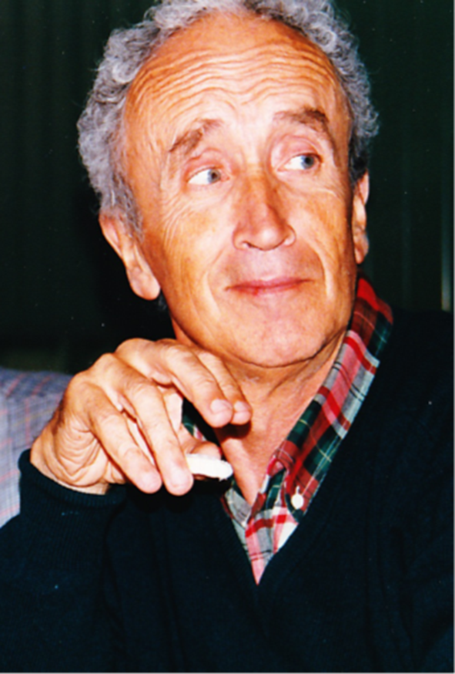
Jim Pilcher Symposium
OPAL and LEP Highlights – a personal view
  Formation of the Collaboration
  Detector
  Physics
  “Sociology”
N.B. OPAL has >430 papers, and still going !!
Notes:
Thank organizers …. Honour for me to visit this prestigious institution for the 1st time.
My wife visited many years ago …
I had no clue how to structure my talk, so I just put together some slides which I though could be of interest. At least they interest me, and hopefully Jim.
When Frank contacted me about this symposium, my immediate reaction was that the talk should be given by someone else, so, to use Powerpoint jargon, let’s fly him in.
Aldo Michelini was the OPAL Spokesman …

Slide 2
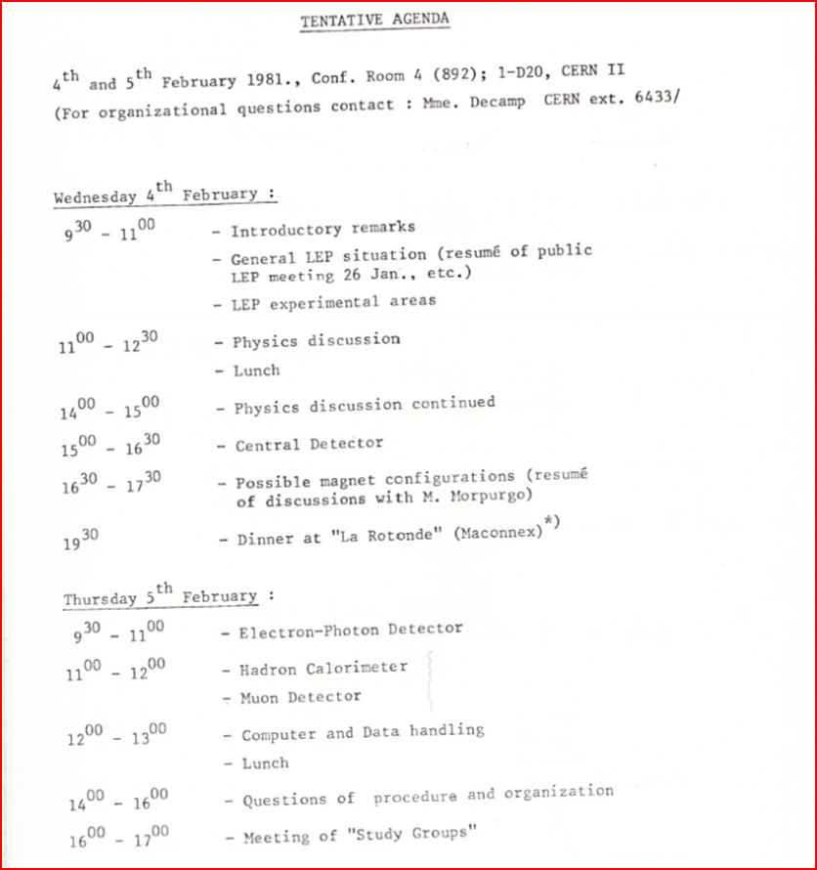
OPAL Early Days : 1980-81
1980:
  Uppsala Conference on Experimentation at LEP
  Preparatory Meetings, preliminary design based on JADE & CERN.
  Thin SC coil 5-10 kG
1981:
  Jan: - meet NA3 colleagues.
  4/5 Feb: - first (OPAL) meeting.
  June – Villars meeting (marriage market ?)
  End year – first ideas of a design and general guidelines (high resolution tracking etc., based on techniques where the collaboration has specific experience, be ready for 1st operation, ….)
Notes:
Combine slides 2 and 3 ?????

Slide 3
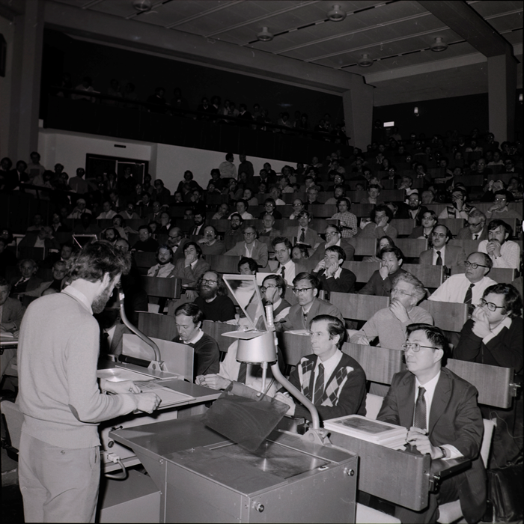
Early Days : 1981-83
October 1981
LEP Approved & OPAL baptized !!
January 1982
Submit Letter of Intent,
with 1 Tesla sc coil.
LEPC wants cost reduction.
Nov: 1982 – LEPC recommends
OPAL with:
  Warm coil !!!
  Pointing LG geometry
  Successful test of FSP
April 1983 : Technical Proposal
June 1983 : Final OPAL Approval.
Jan: & May 1983 : W and Z discovered

Slide 4
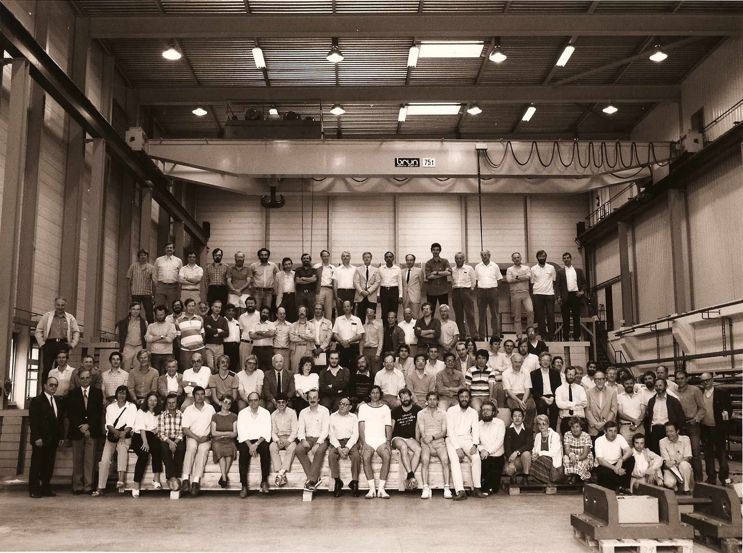
Notes:
1985 ??? Check
Don’t forget Mette, our very welcoming Secretary.

Slide 5
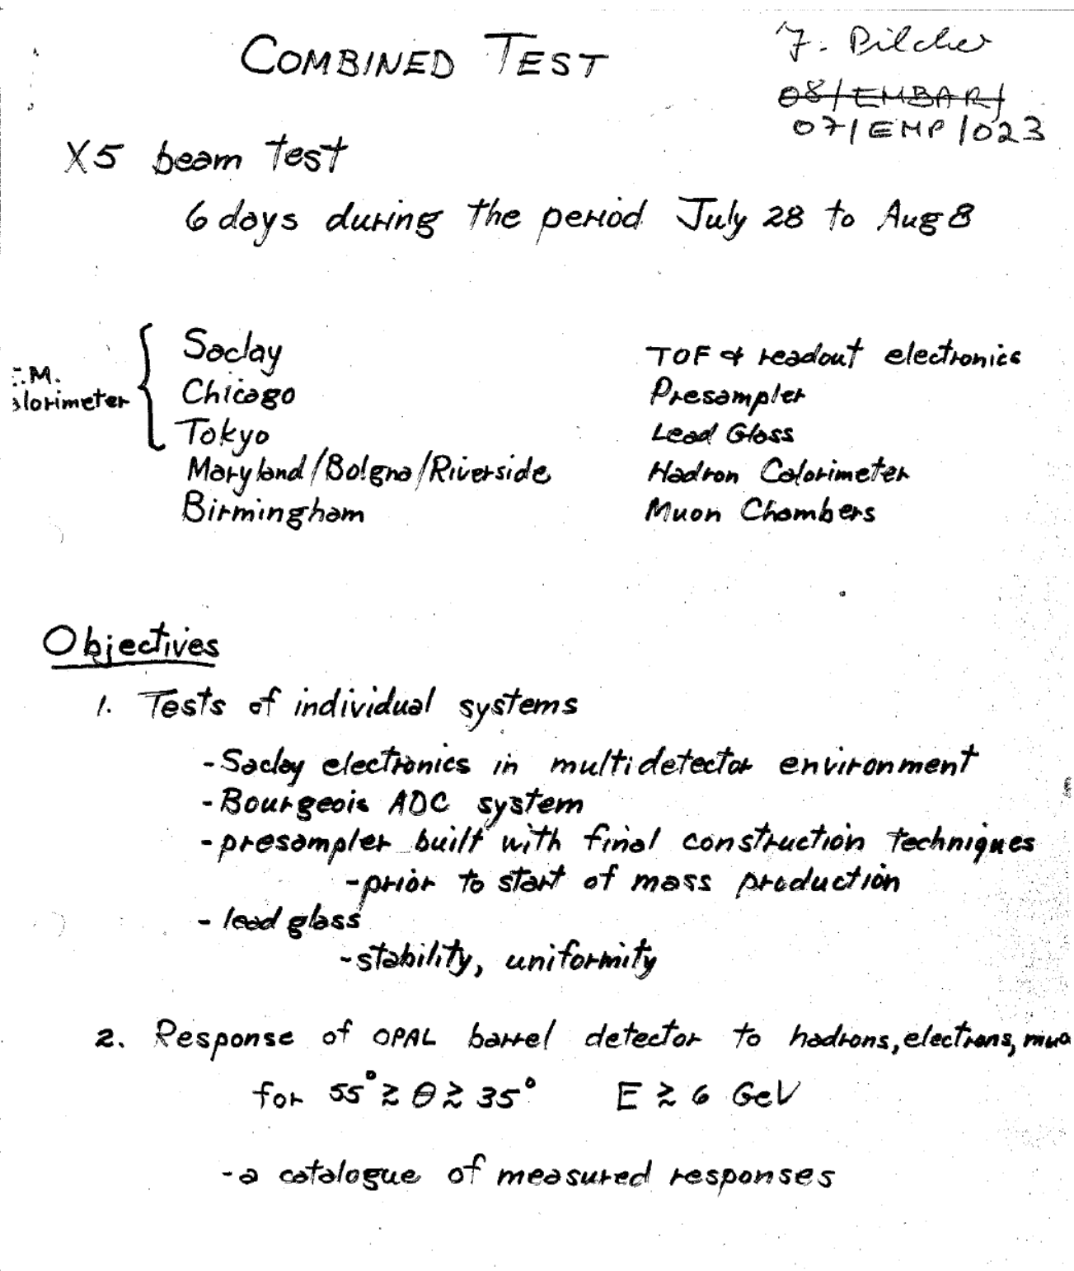
1985
1980’s
Huge Test Beam programme, mainly at CERN but also SLAC.
“Combined Test” particularly fruitful.
“Chicago Stage” came in very useful.
Notes:
A major milestone in OPAL’s preparation. Jim organized much of the test.
CHICAGO STAGE.

Slide 6
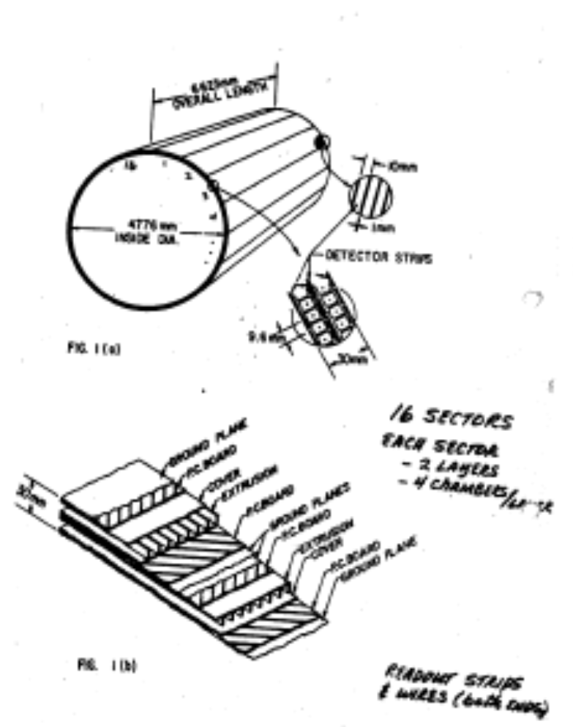
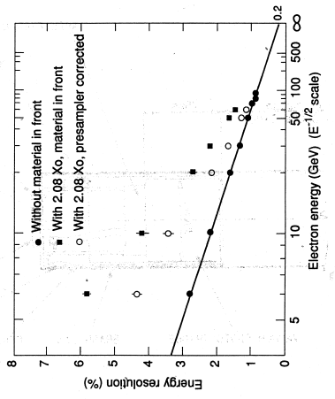
OPAL Presampler Barrel (PB) and improvement in energy resolution of the electromagnetic calorimeter.
Notes:
Outside the coil and central detectors, and just inside the ECAL. Limited streamer mode chambers.
Note the improvement in resolution.

Slide 7
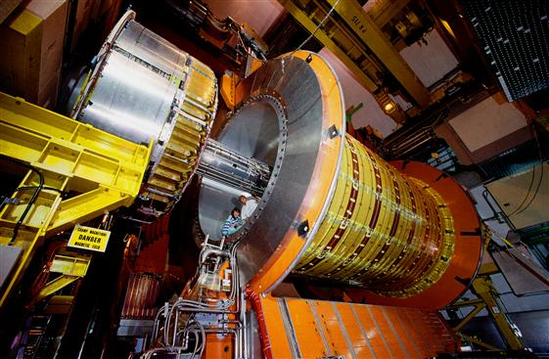

Slide 8
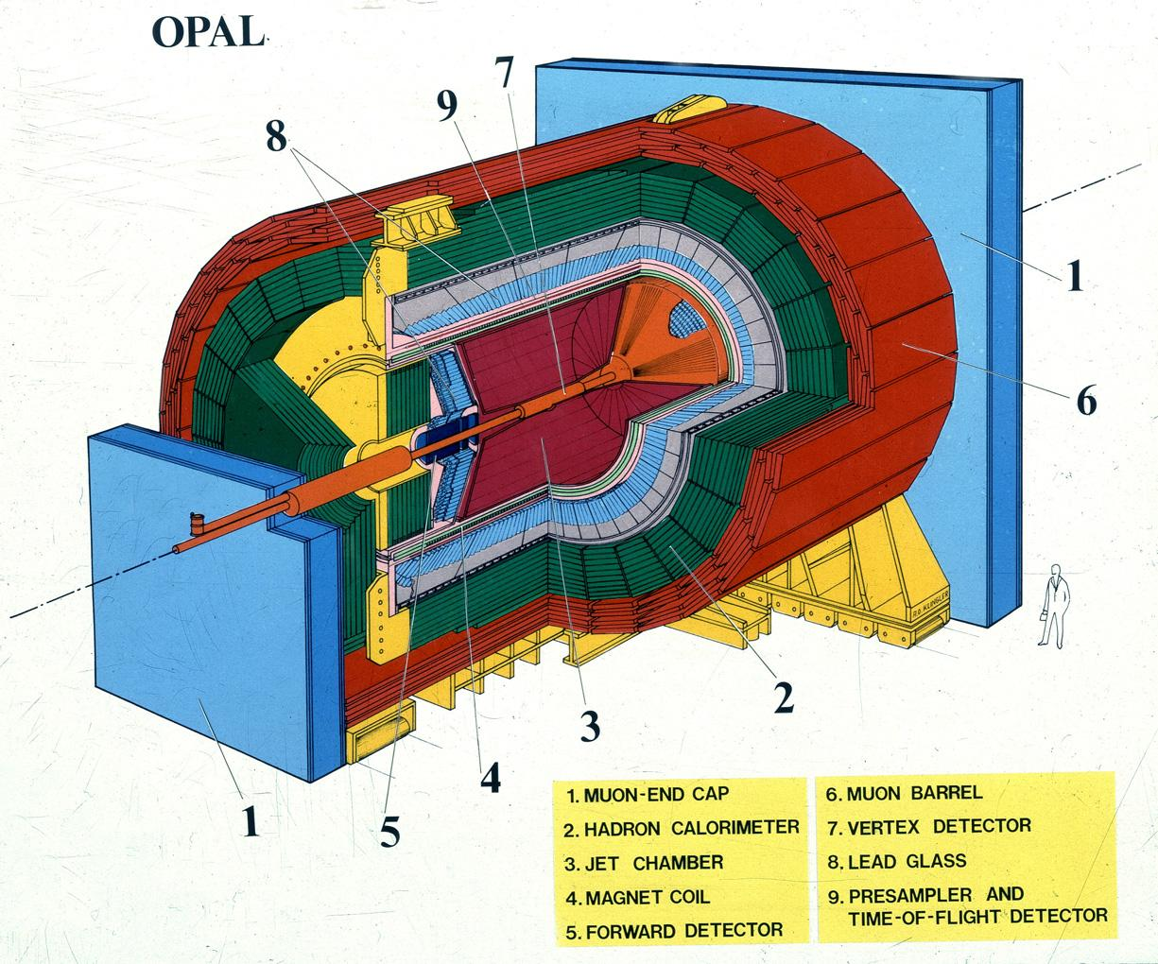
Overall size 12*12*12m
Notes:
Mention location of Control Room.

Slide 9
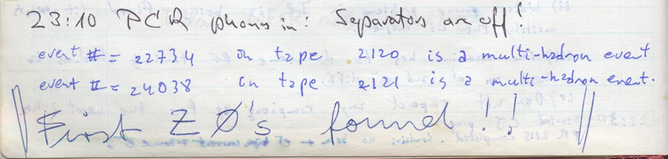
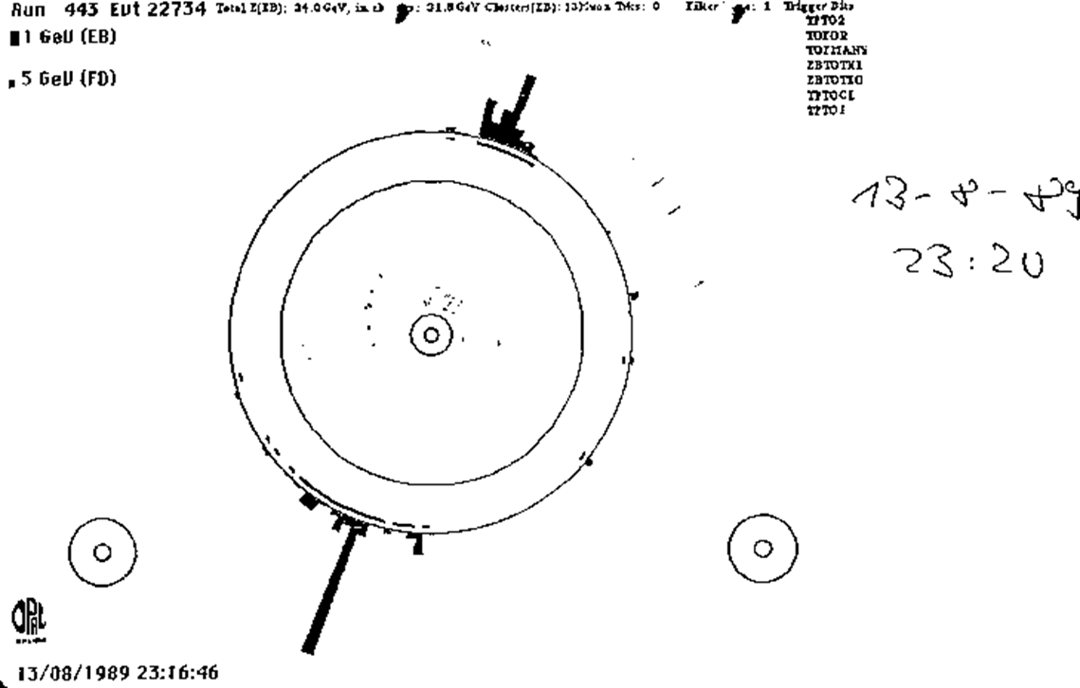
The first Z⁰
13 August 1989, 23.20

Slide 10
First Results - CERN 13.10.1989

Slide 11
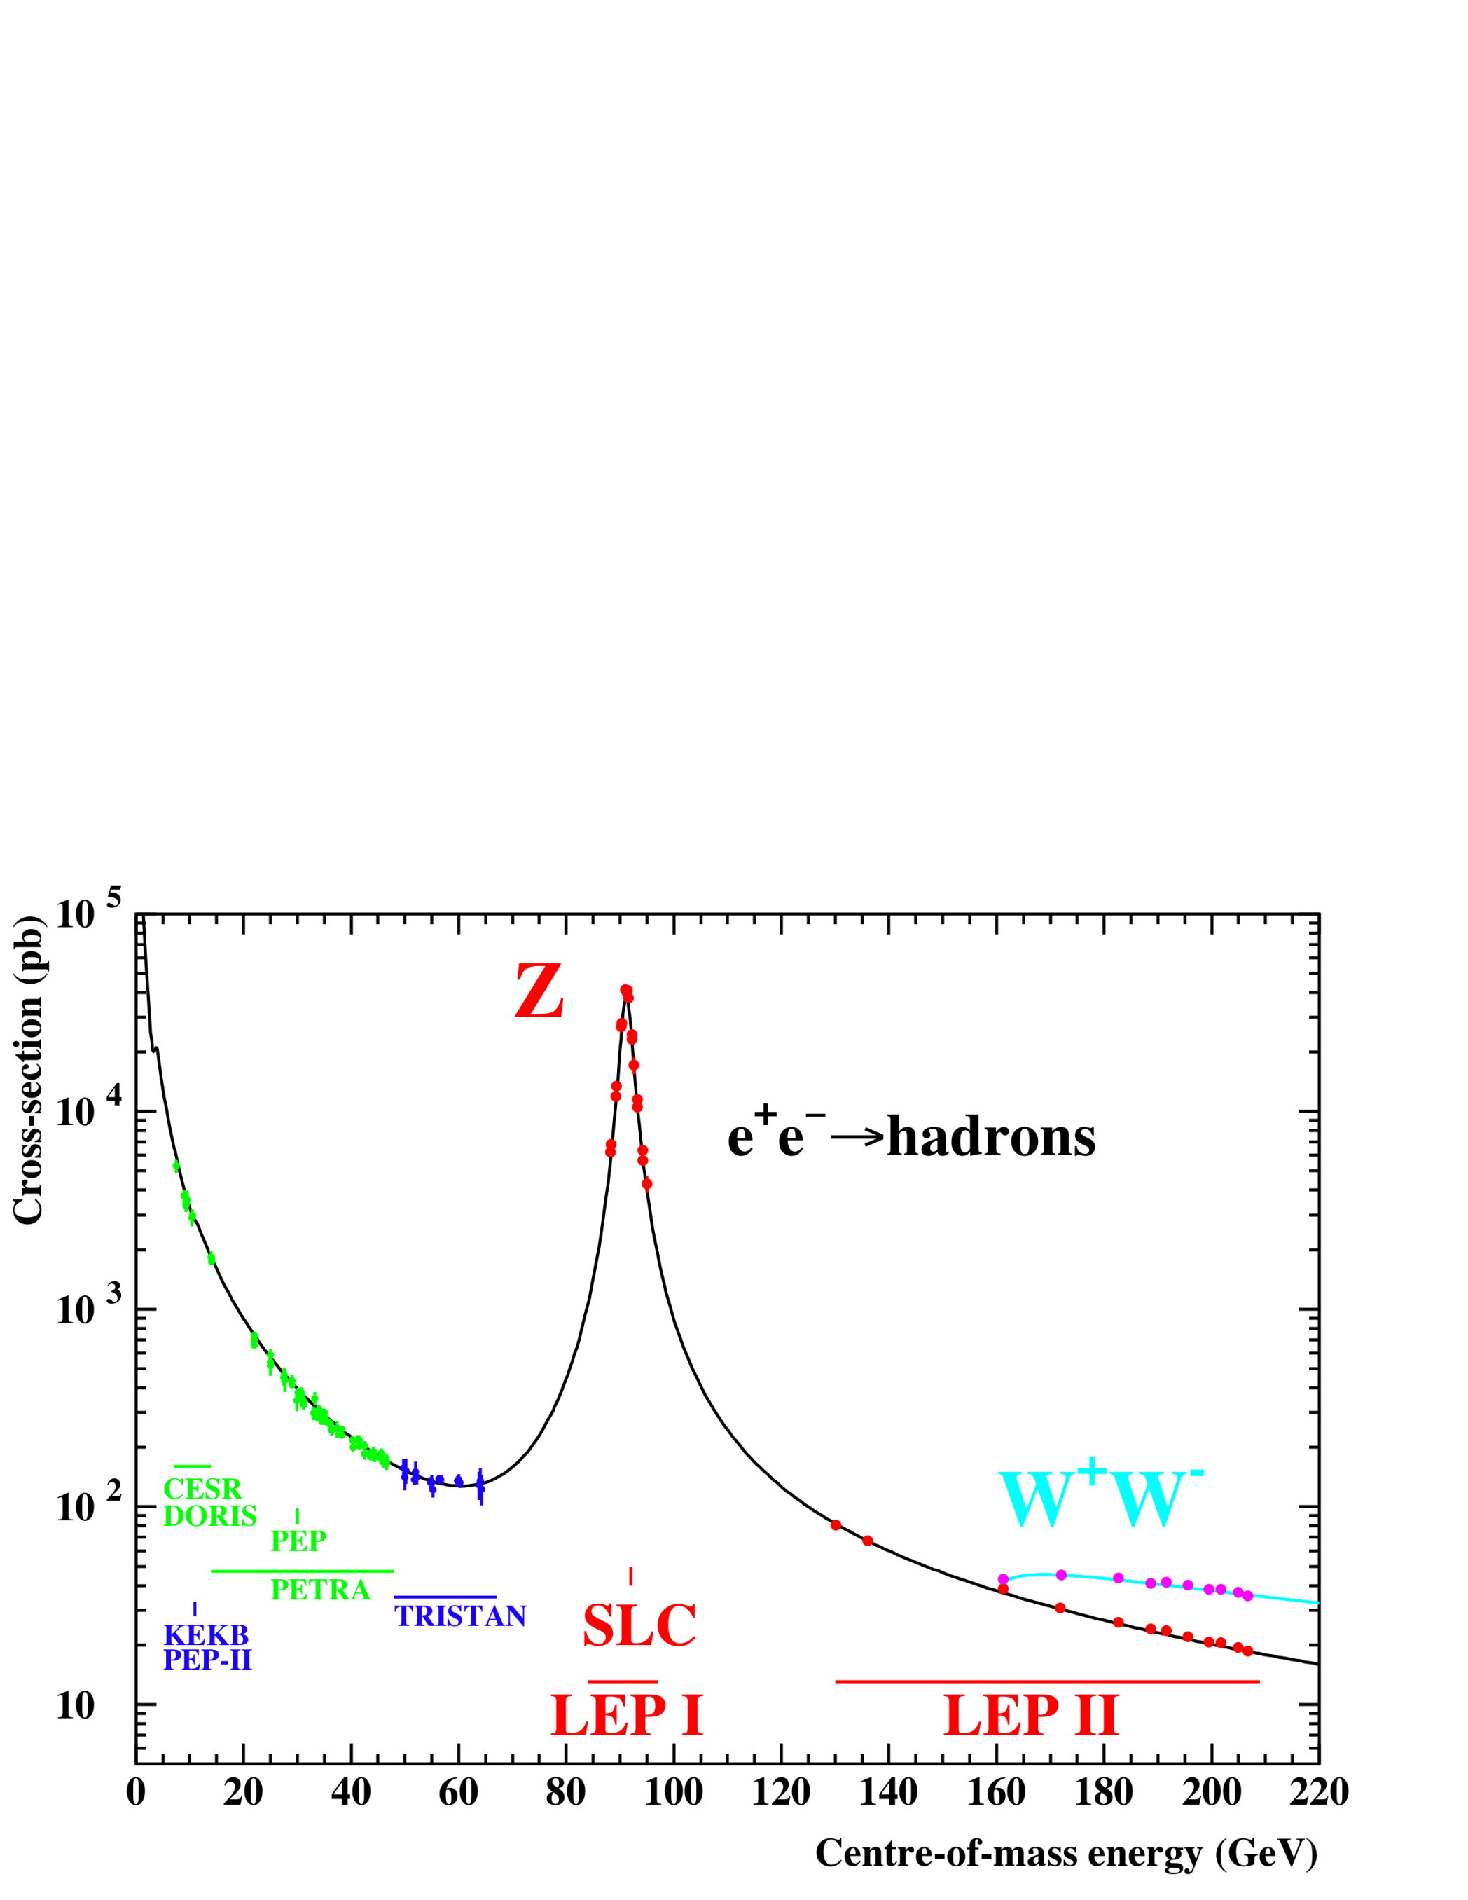
Notes:
Playground. LEP1, LEP1.5, LEP2. No LEP3 for the time being, but who knows?
We have access to lower energy JADE data.

Slide 12
Now for some “Zedometry”
Crucial to precise determination of the Z mass and width are :
  Good Knowledge of the LEP beam energies
  Luminosity measurement
  Many systematic effects
  I will dwell somewhat on the first since several interesting and unexpected effects were uncovered over the years.
Notes:
By Zedometry I mean the Z0 lineshape. I’ll leave most of that to David Strom.

Slide 13
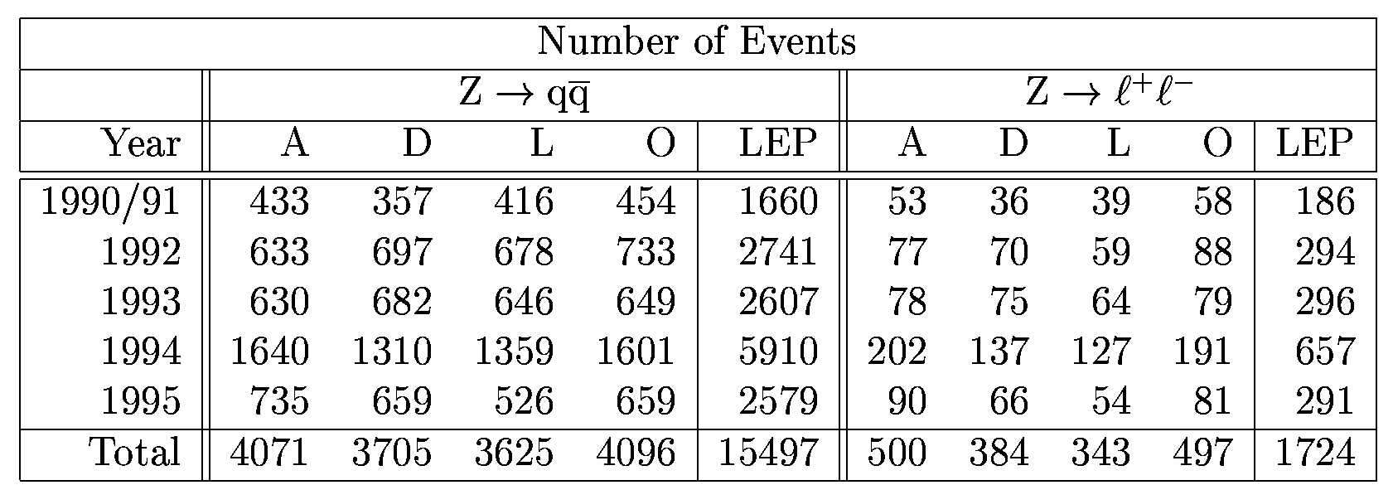
The event sample around the Z⁰

Slide 14
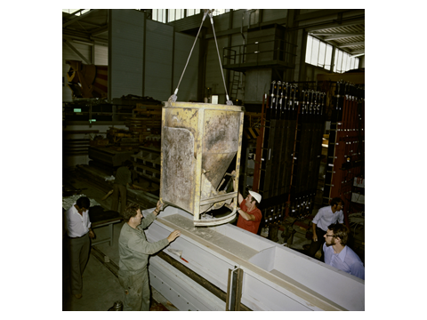
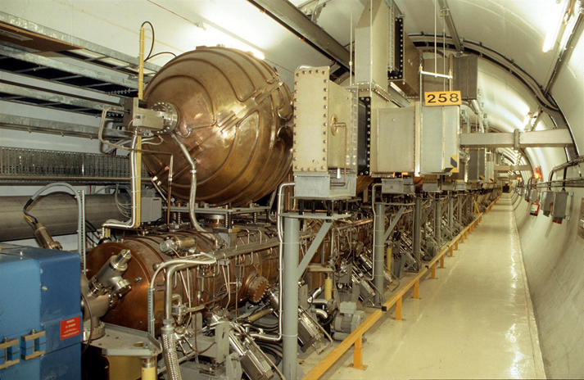
LEP Beam Energy Measurements
Two machine innovations provided us with unexpected challenges :
“Concrete” magnets.
B ≈ .05T at Z peak.
Energy storage cavities
A third innovation was the Nb-sputtered Cu s.c.cavities.
Notes:
Magnets 1.5mm Fe laminations separated by 4.0mm concrete/mortar – 40% cost savings wrt classical Fe magnets.
RF – savings = 40%. n MCHF/year.
SC cavities. 25% saving wrt Nb cavities, and some technical advantages. Heat conductivity of Cu 10* Nb – better thermal stabilization of any surface defects and higher fields.
For warm cavities, most RF power dissipated as heat in the cavity walls, so Power ~ Eb^8

Slide 15
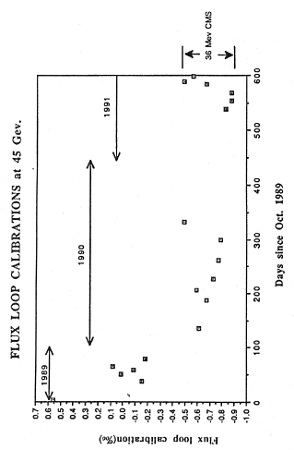
Early Flux Loop Calibrations
Every dipole magnet has a 1-turn “Flux-Loop” installed in a groove in the lower pole.
Notes:
Mortar dries out. 2 effects, longitudinal and transverse :
Magnets get shorter.
Transverse : Fe under stress.
Last point made with WARM magnets at end run – others with cold magnets.
≈10⁻⁴/⁰C

Slide 16
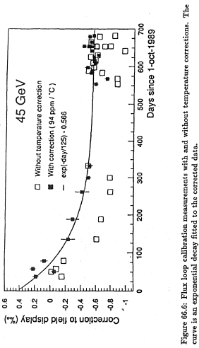
Temperature Corrected F-L Calibrations
Notes:
Most early measurements made with COLD magnets.

Slide 17
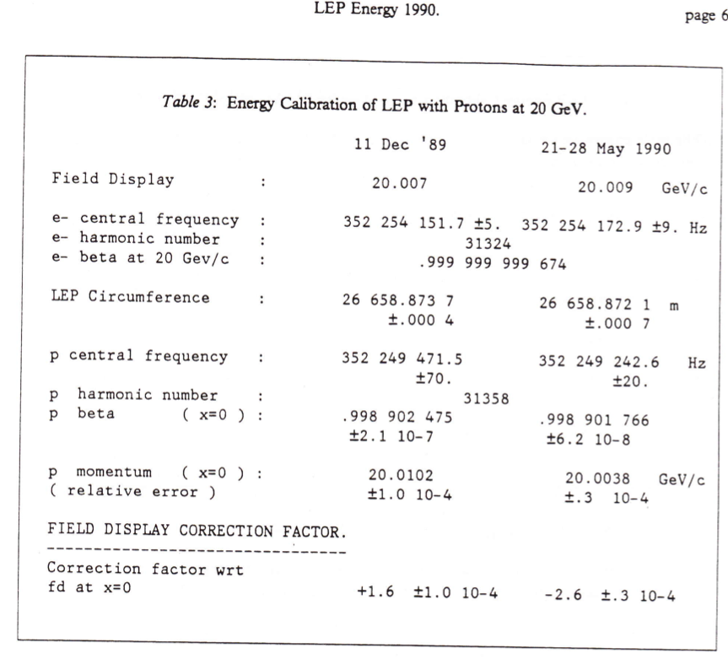
First circulating protons
11 Dec 1989
1989 & 1990 @ 20GeV
With e and p on same central orbits, infer speed of protons by comparing different RF frequencies.
From speed compute momentum.
Extrapolate to 45GeV using flux loop.
20 MeV uncertainty on M_{Z}
LEP circumference shrank between measurements by 1.6±0.8mm (hint for future?)

Slide 18
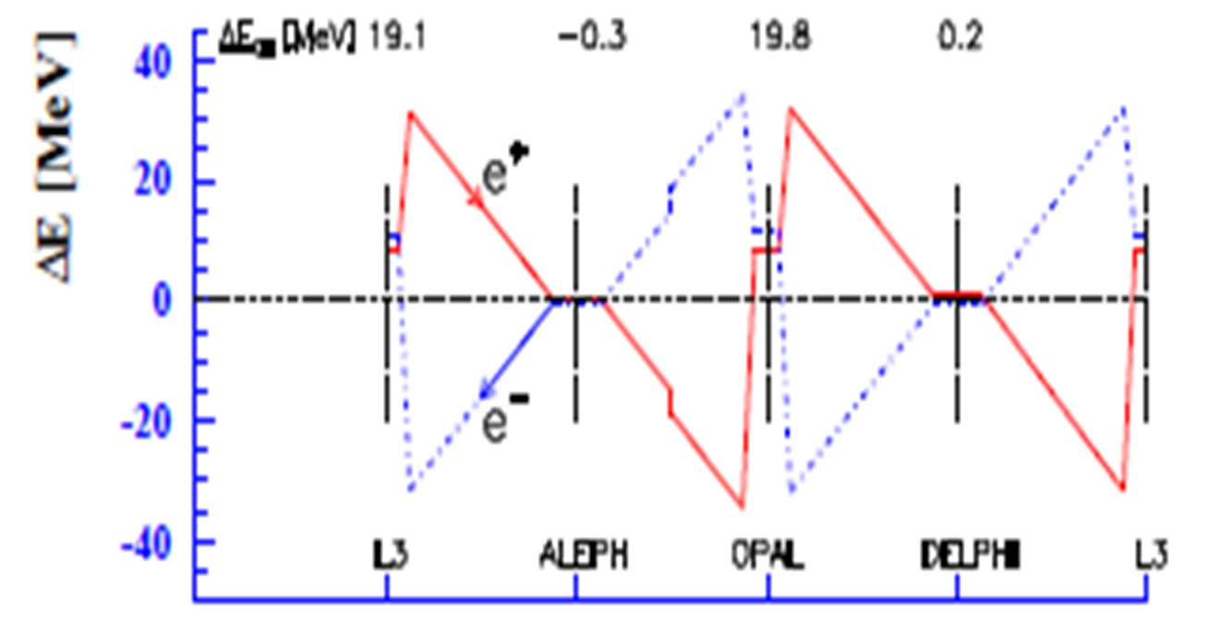
Those warm RF cavities
Beam energy varies around the ring - energy sawtooth.
LEP1 : RF cavities (warm) at Point 2 (L3) and Point 6 (OPAL) only.
Notes:
NB. No RF at ALEPH and DELPHI. It had been assumed that the cm energies were the SAME at all IPs !!!!!!!!!!!!
Cu cavities driven by 2 frequencies – aligned to higher frequency (not average). Therefore e+ end e- didn’t get same energy boost. Therefore – keep track of the RF configuration.
Relate the history?

Slide 19
Those warm RF cavities
Beam energy varies around the ring
  Synchrotron radiation in the arcs
  Energy restored by the RF cavities (originally at IP2 & IP6)
  If cavities are precisely positioned, beams gain the same energy on the way into the IP and on the way out.
  E_{CM} equal at all IPs
Copper cavities driven
by TWO frequencies
  RF power oscillates
  between storage and
  main cavity.
  Aligned to wrong freq!
  E_{CM} shifts at L3 and
  OPAL of 10~20 MeV
Notes:
Skip

Slide 20
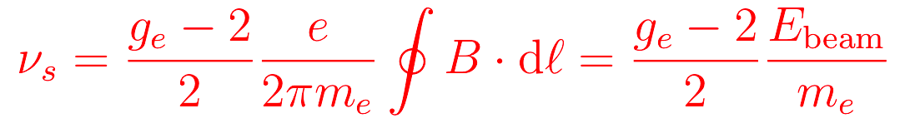
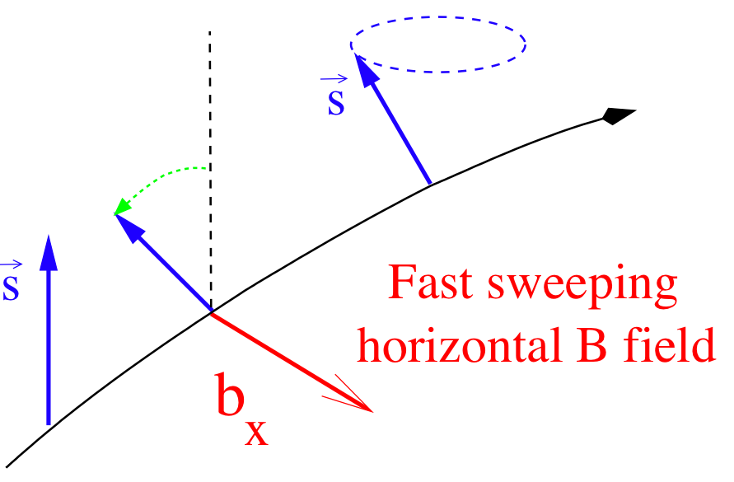
Resonant depolarization - ultimate presision
Electron spin aligns with vertical B field of dipoles due to synchrotron radiation
Slow (hours) build up of polarization if the beam orbit is sufficiently smooth.
Spins precess - number of precessions per orbit (spin tune):
Monitor polarization and
scan frequency of external
B field to depolarize and measure ν_{s}
o(100keV) instantaneous
precision on average E_{beam}

Slide 21
LEP Alignment Problems
LEP mis-alignment in the vertical plane - measured in 1991/92 shutdown.
Note the scale !!!!
No wonder it’s difficult to achieve polarized beams.
Notes:
Surveyors told to align quads to 0.1 mm. Here see 17 mm offset !!!
George Mikenberg lived above 17 mm offset !

Slide 22
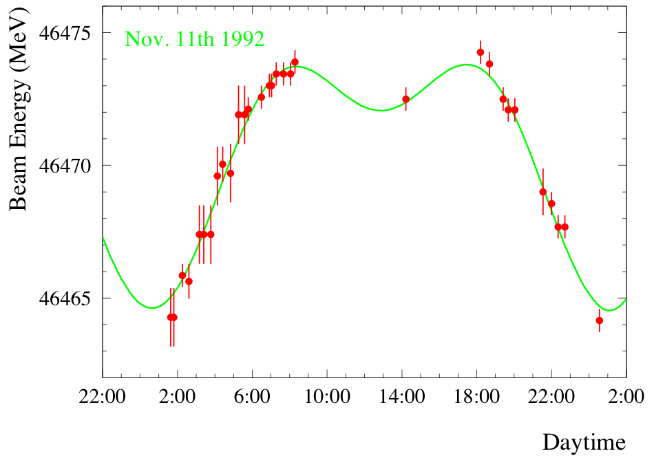
Lunar Tides in the Earth
Tidal forces do not only move the waters of the oceans, They also move land masses.
Vertical motion in GVA up to 0.2m peak-to-peak.
Horizontal dimensions undergo similar relative changes → 1mm change in LEP circumference.
Length of beam orbit fixed by RF frequency.
Beam stays where it is – magnets move around it.
Extra contribution from quadrupole fields off central orbit changes E_{beam}
Amplitude ~10MeV
Notes:
Tidal forces do not only move the waters of the oceans, but also land masses. GVA- vertical motion of up to 0.2 m peak-to-peak. Corresponds to relative local change if earth radius of 3 10⁻⁸.
Horizontal dimensions undergo similar changes. Up to 1 mm change in LEP circumference.
ΔE/E = .5 10⁴ ΔR/R (mom: compaction factor ≈ 2-4 10⁻⁴ )
Beam Energy measured over many hours. Green curve is prediction of lunar tide model.

Slide 23
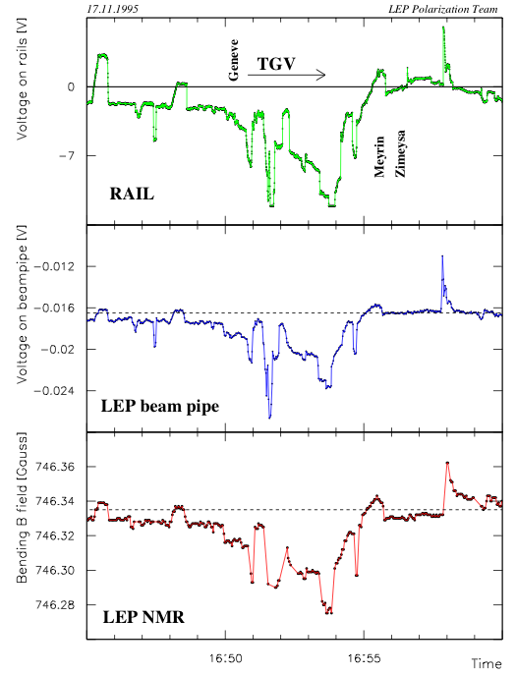
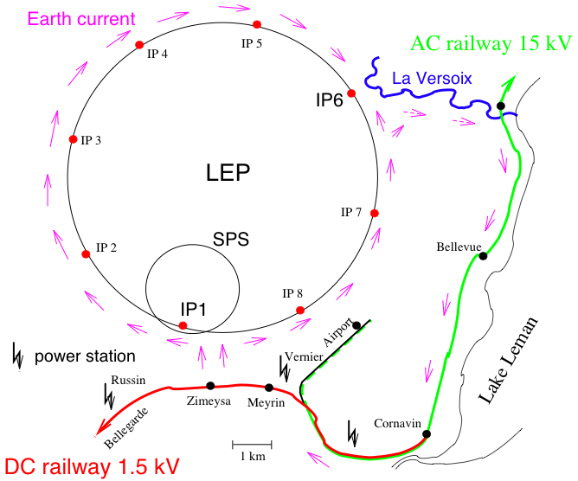
We discovered trains , & other effects
Vagabond currents from French DC electric trains
Measured current on beam pipe and NMR field change
Notes:
A fraction of the direct current powering the trains on the Geneva-Bellegarde line returns to the generator station via the LEP beam pipe.
Top plot : voltage on the rails.
Middle : voltage on LEP beam pipe.
Bottom : Magnetic field in bending magnets.

Slide 24
Corrections for pre-1995 data
Extrapolating back from end-of-fill resonant depolarisation measurements, take into account :
  Earth tides.
  Horizontal orbit correctors.
  Magnet temperatures.
  Train effects.
  RF configuration, and other IP effects.
Final E_{CM} uncertainty on Z mass : ±1.7 MeV
M_{Z} = 91.1875 ± 0.0021 GeV

Slide 25
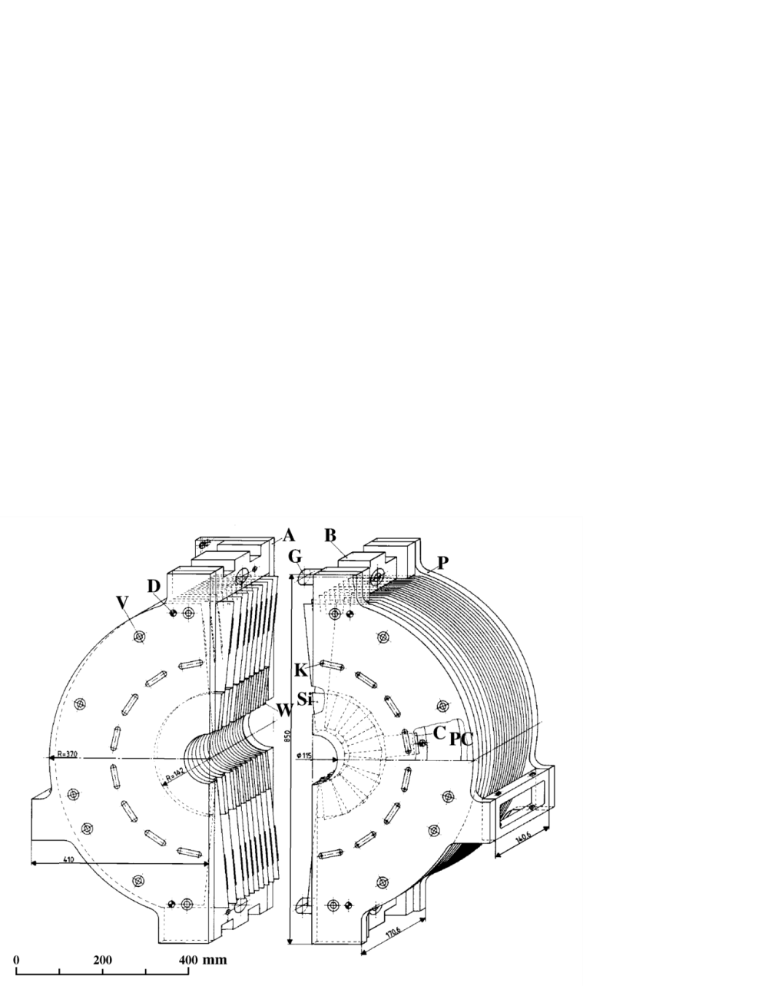
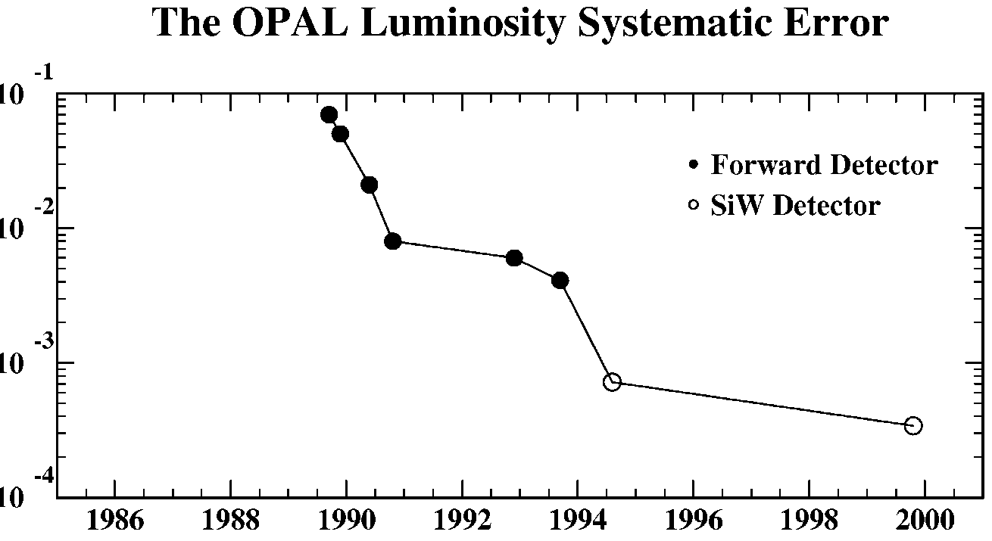
Precision luminosity determination with SiW luminometer
Bhabha SW cross-section = 79 nb
Acceptance edge controlled to 7 μm
The following experimental systematic errors were achieved :
ALEPH : 0.067%
DELPHI : 0.09 %
L3 : 0.064%
OPAL : 0.033%
Theoretical Uncertainty
Notes:
Anchoring.

Slide 26
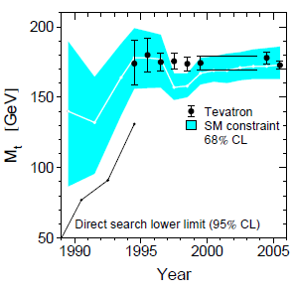
Z0 Mass and Width, Number of Neutrino species
LEP combined values:
Mz = 91.1875 ± 0.0021 GeV
Γz = 2.4952 ± 0.0023 GeV
No: of ν species = 2.9840 ± 0.0082
and
Predict m_{top} from electroweak fits
to all LEP1 EW data
Notes:
Nneutrinos 2 σ below and integer value.

Slide 27
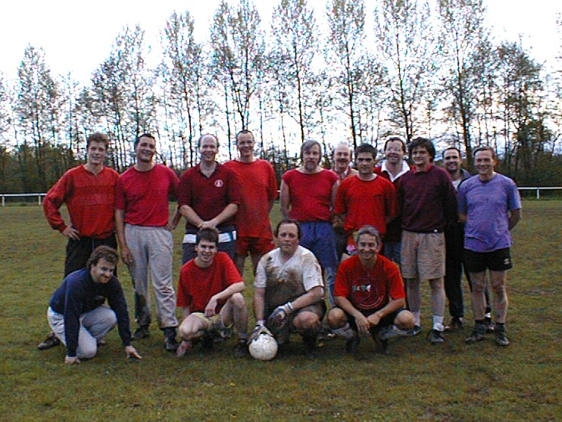
A social interlude
Notes:
4 OPAL Plenary weeks/year. OPAL dinner.
Football – 2 goalkeepers, not at same time.

Slide 28
A social interlude
One of our goal keepers achieved international standing !!!
Guess who ?

Slide 29
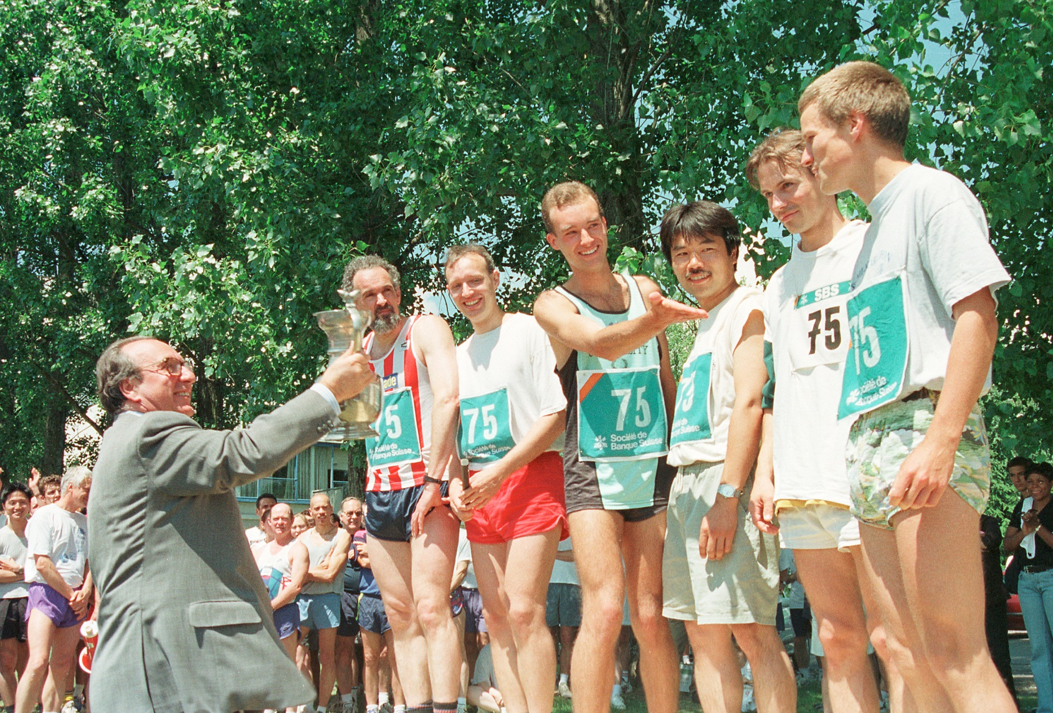
A social interlude continued

Slide 30
OPAL Papers (≈ 430)

Slide 31
Chicago colleagues contributed the following papers ….
EW/SM - Lineshape, F-B asymmetries, Bhabhas, Precision Lumi measurements, Z→bbar,
Single γ events (N_{ν}), ll+V (LEP1.5), W-mass, W production, ZZ production.
Searches – Heavy leptons, Free gluons, neutralinos, di-γ resonances, RPV limits, Technipions.
QCD – comprehensive review.
Higgs – SM Higgs, Charged H, Decay-mode independent search, H→WA, H→γγ,
Flavour independent search.
Taus – BRs (lots of ‘em), Polarization, Topological BRs, CPinv: in ΓΓ, Lifetime, ANN algorithm for Γid, F-B polarization asymmetry.
B : B⁰/B⁺ lifetime difference, b→e,μ, B lifetime,
B→D**lν, b-tagging using 3D silicon info:.

Slide 32
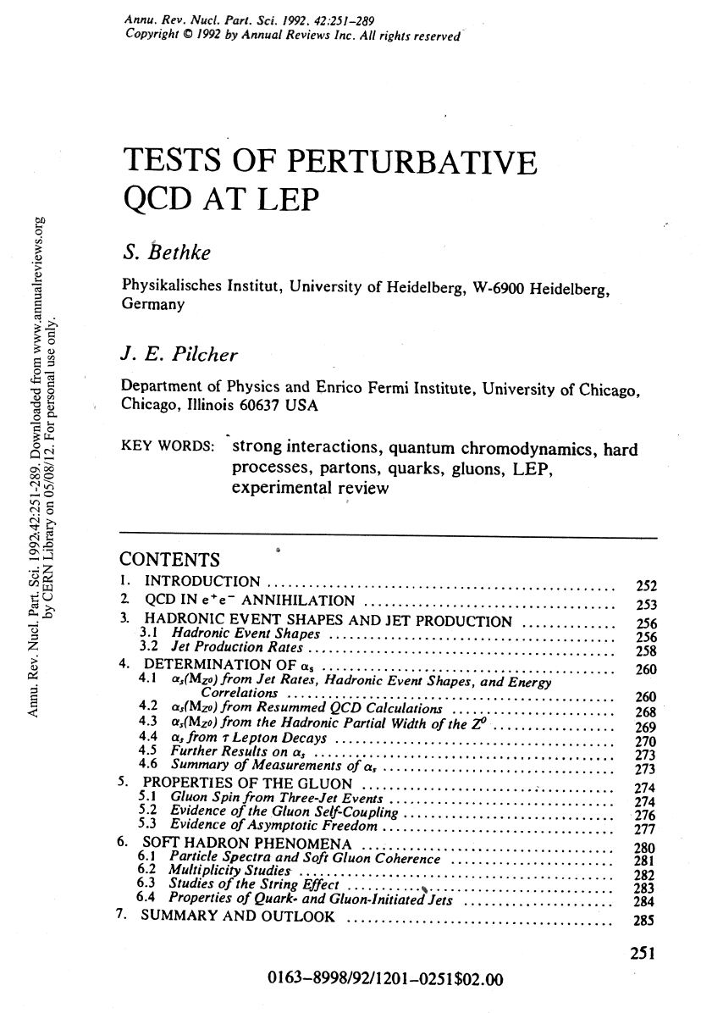
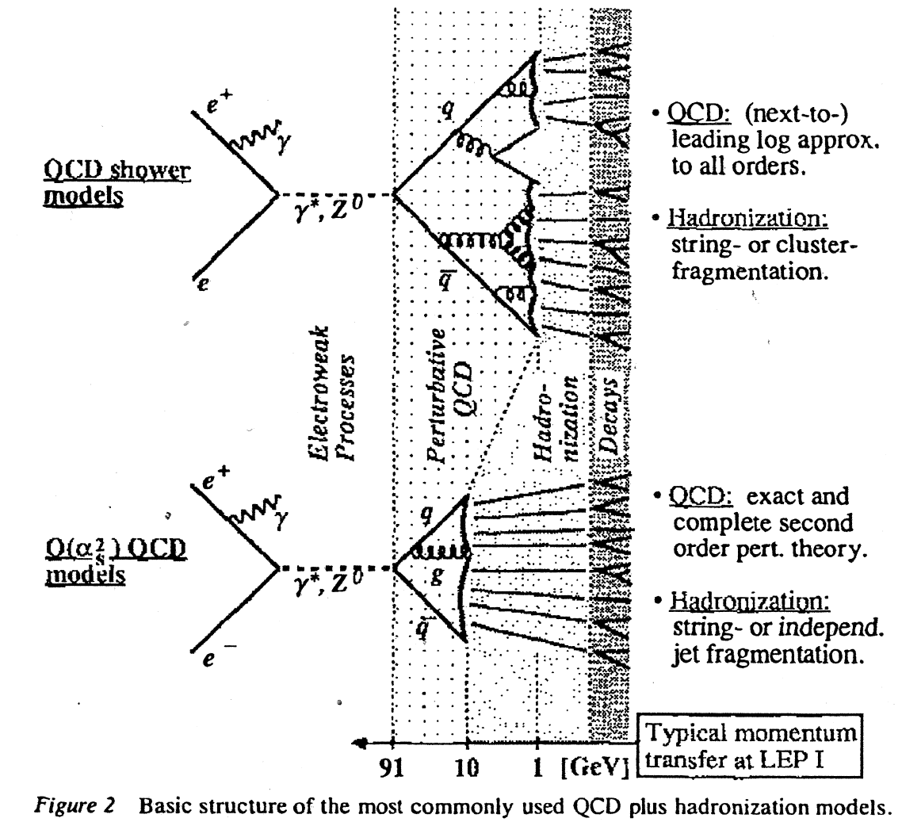
Tests of perturbative QCD at LEP - 1992
Complete overview of QCD- related measurements at LEP as of 1992, and an excellent introduction to the subject.
Notes:
Here is an early paper which I have referred to many times.

Slide 33
1994 : Busy and Good Year for OPAL
Best year on the Z⁰ !!!!!
Special year for Jim – as OPAL Physics Coordinator.
As far as physics output is concerned, PC’s are in charge:
quantity and QUALITY of papers, promote and monitor research projects, coordinate M.C production, look after analysis tools, computing platforms, conference submissions, conference talks, ……
Some 1994 Issues :
LEP – “Pretzl” vs. Bunch Train operation → went for the latter. LEPC – discussed longitudinal polarization.
OPAL – acquired new collaborators (Hungary)
- silicon μ-vertex “incident”.
- “looked forward to SI z and SiW (absolute)”.
LEP200 – workshop preparation
- coupler problems on s.c. RF cavities.
LHC – study OPAL removal for civil engineering !!!!!!

Slide 34
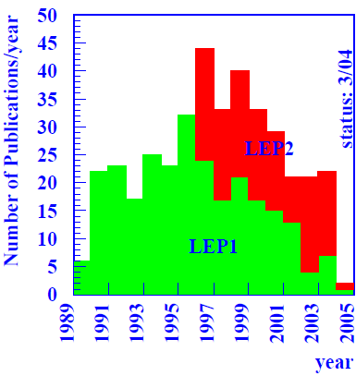
1994 : Busy and Good Year for OPAL - continued
Z0 peak running - 57.9 pb⁻¹ ε = 89.6%
June Plenary – David Wagner (Chicago) spoke on
“OPAL and the World Wide Web”
Slide 1 title “What is the World Wide Web ?”
He concluded : ~ “Give it a go : take it or
leave it”
Autumn Jim proposed a very important
document on
“Guidelines for OPAL Physics Notes and Papers”,
a 1-page paper. Now its 6 pages long.

Slide 35
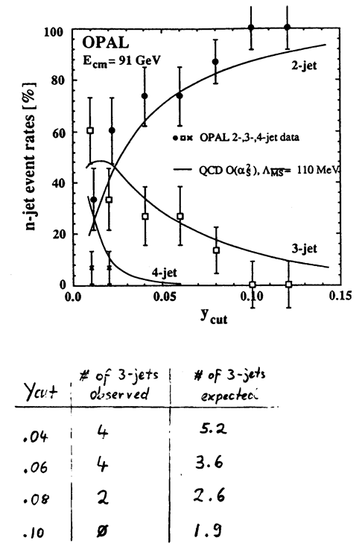
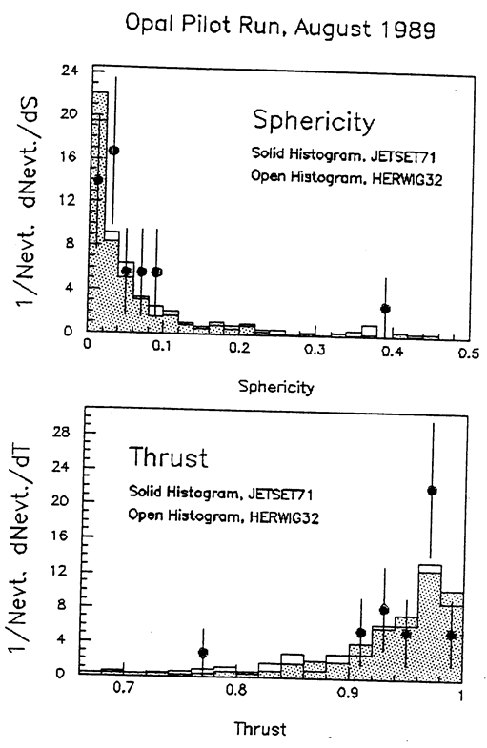
QCD : an Early Start – 1st Physics with 18 mulithadrons !!!!!
Event Shapes and Jet Rates
Notes:
A few words about QCD studies.

Slide 36
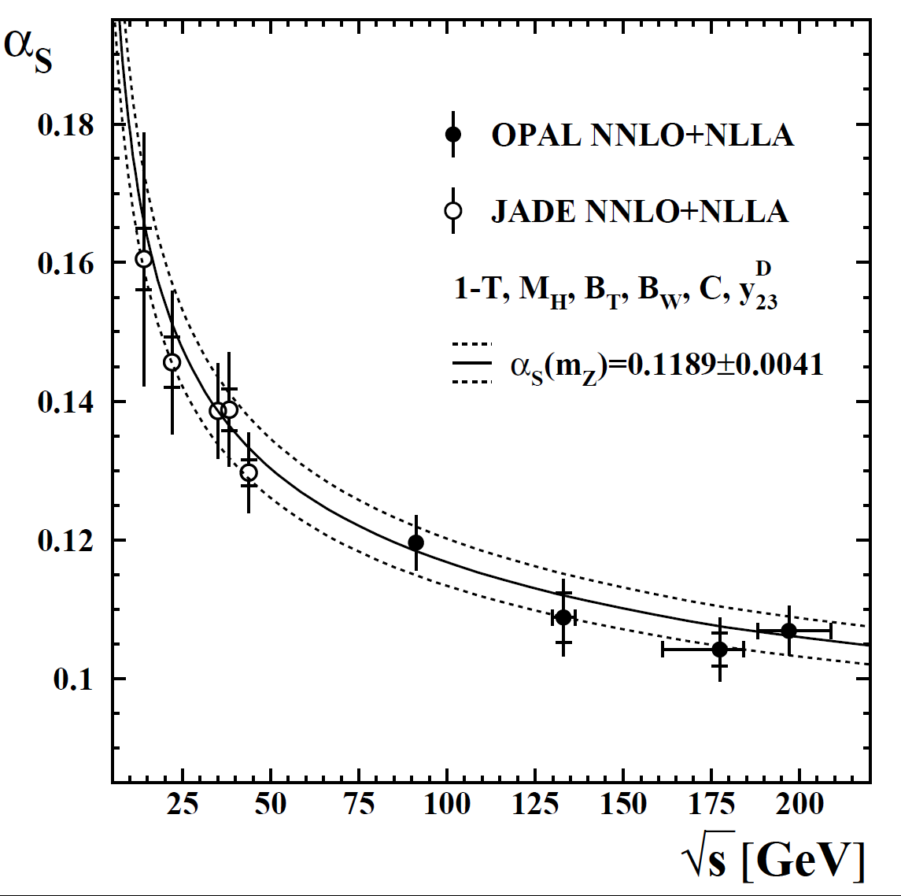
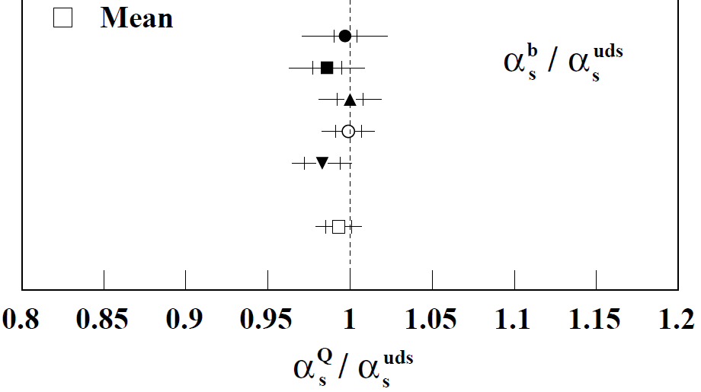
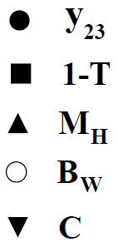
QCD measurements – two related experiments
Decay of Z→qq is a QCD laboratory
  Very clean initial state, production of different flavours (some taggable)
  Measurements of α_{s} with jet rates, event shape observables, etc
    Here thrust, heavy jet mass & broadening, C-Parameter, y₂₃^{D}
    Interplay between improved theoretical and experimental techniques
  Measurements of colour factors
Reanalysis of JADE data with OPAL
  Cover E_{CM}-range of 35-200 GeV
  Take advantage of theoretical developments since JADE
    And some computer archaeology
Repeated for flavour tagged samples, taking mass effects into account.

Slide 37
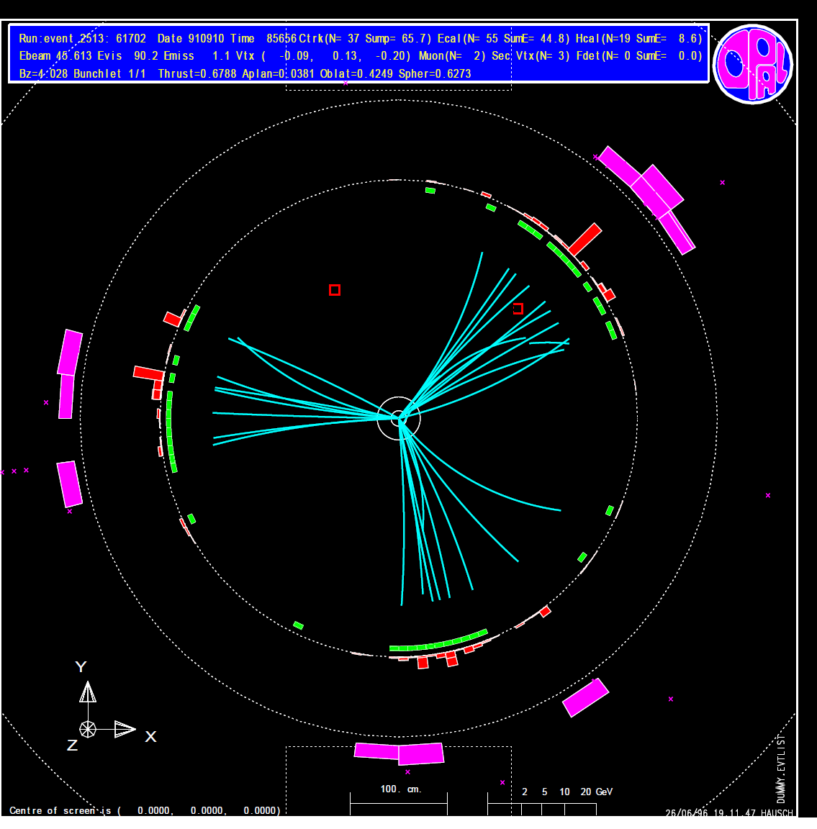
QCD measurements – quark-gluon jet differences
Quark and gluon jets with equal energies
  Symmetric event topology
    Angles between the highest energy and each of the 2 lower energy jets were the same
  Quark jets Identified in 3-jet Z⁰ events using reconstructed secondary vertices from heavy quark decays and energy ordering to anti-tag gluon jets
Gluon jets exhibited
  Larger angular width that quark jets
  Softer particle energy spectrum
  Larger particle multiplicity
    <n>_{gluon}/<n>_{quark} = 1.422 ±.051

Slide 38
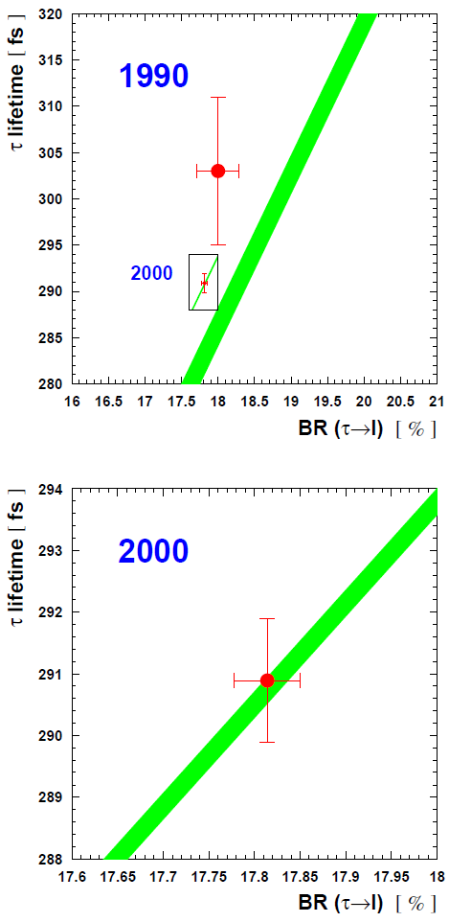
Tau Physics
2 “longstanding τ puzzles” at the outset:
τ one-prong puzzle.
τ lifetime and BRs exhibited >2σ discrepancy (lepton universality in trouble).
One form of this check :
(g_{τ} /g_{μ})² = (τ_{μ}/τ_{τ}) (m_{μ}/m_{τ})⁵ BR(τ →eν_{e}ν_{μ} )
τ-lifetime measured to ~0.7%
  1-prong decay: impact parameter
  3-prong decay: secondary vertex
    Reconstruction of beamspot crucial
  N.B. The scales on the 2 plots are very different.
Notes:
Change dominated by Γ lifetime :
effect of M(tau) = -2%
effect of lifetime = -4.7%
effect of BR = .06% wrt 1990 situation.

Slide 39
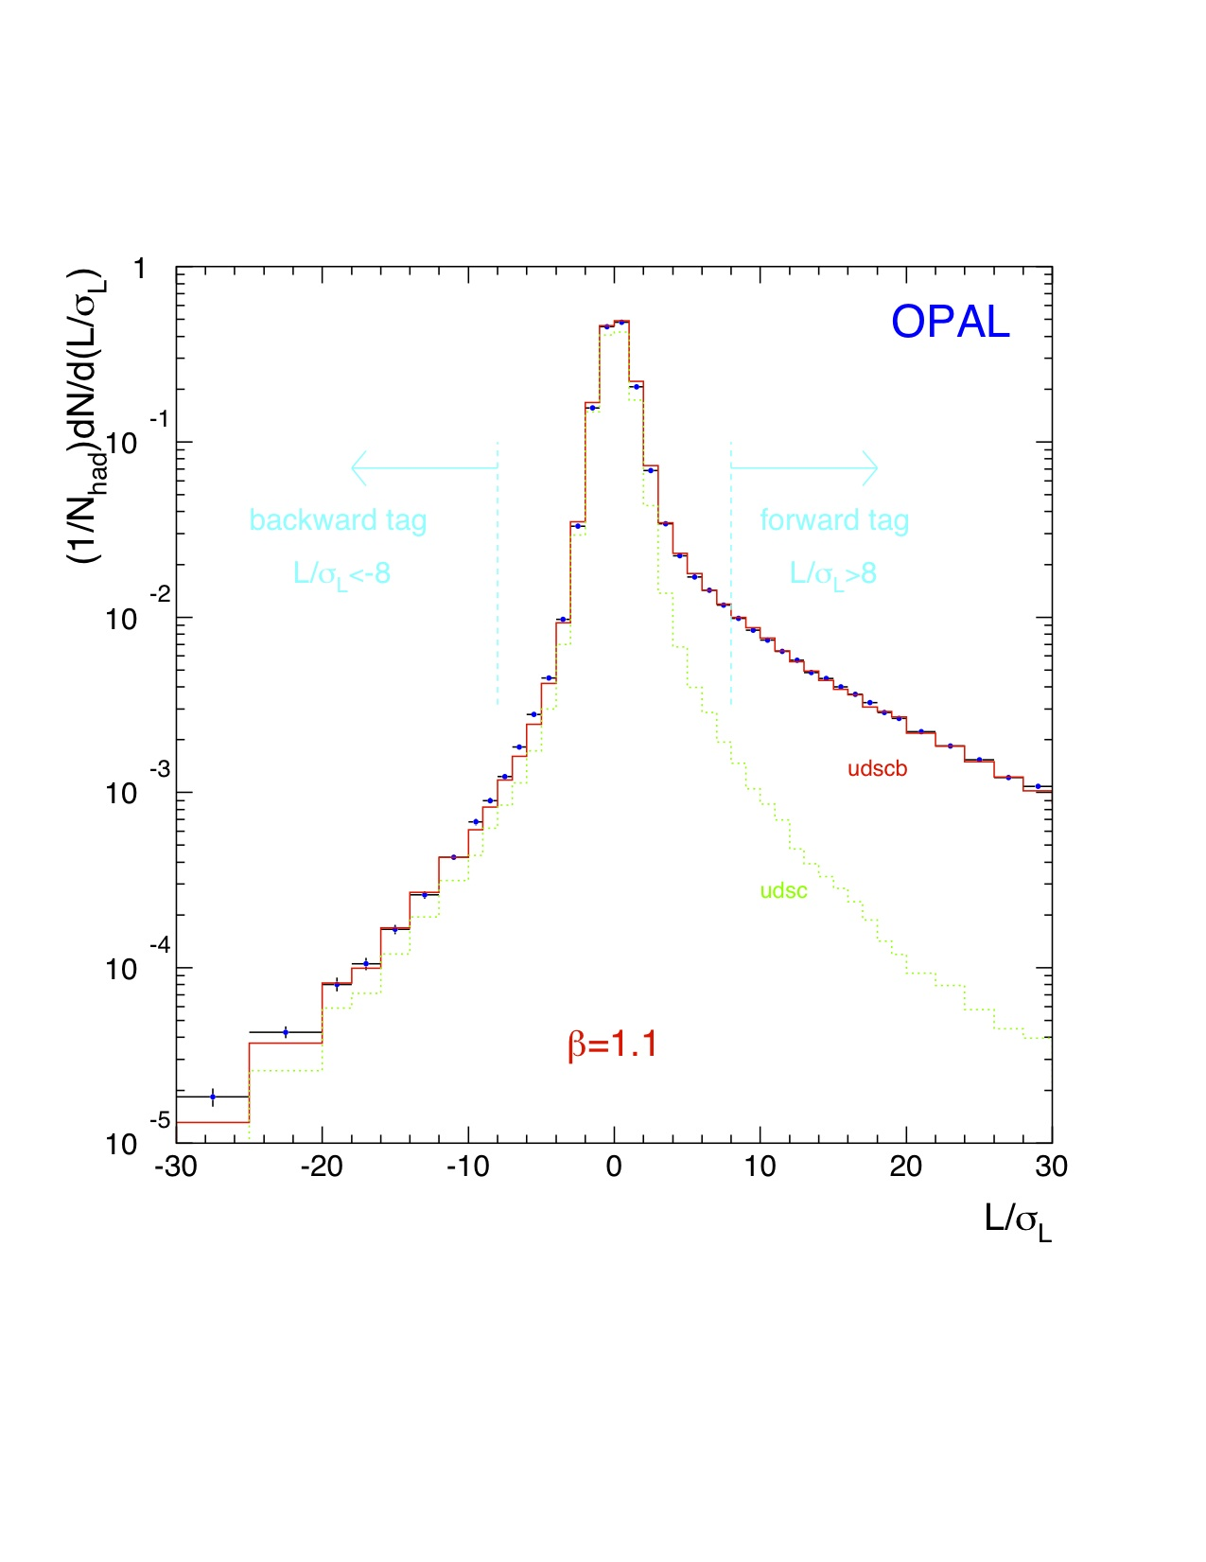

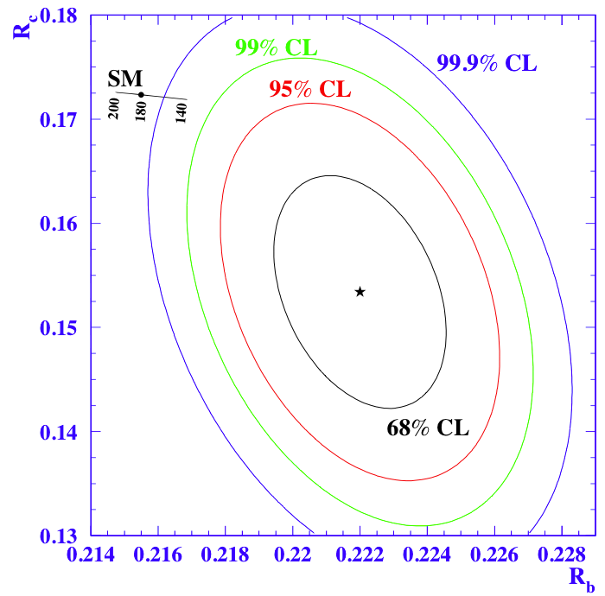
R_{b} Measurements : some interim excitement
Tagging b-decays with leptons and displaced vertices – R_{b}
Initial results higher than SM
  EPS-95 Brussels – the ‘flying pig’
  R_{b}=0.2219±0.0017 c.f. 0.2155 SM
    Some interplay between R_{b} and R_{c}
1994 data – 2D L/σ
A long road to resolve this ‘R_{b}-crisis’
  Improved tagging: 3D vertex, alignment, NN tag
  Understanding of tag correlations
  Multitag measurements with charm
  Measurement of g→bb
  Systematics and more systematics…
Finally, Rb=0.2163±0.0007 from LEP combined
EPS-95
Notes:
Top plot – lifetime tagging, decay length significance.

Slide 40
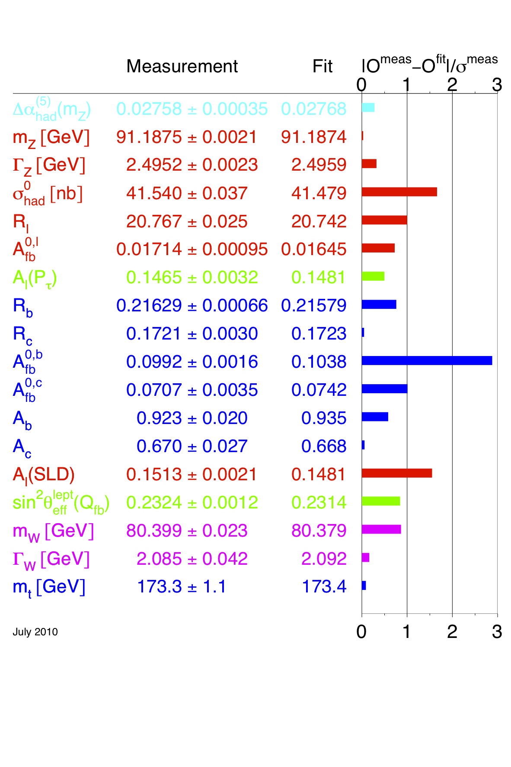
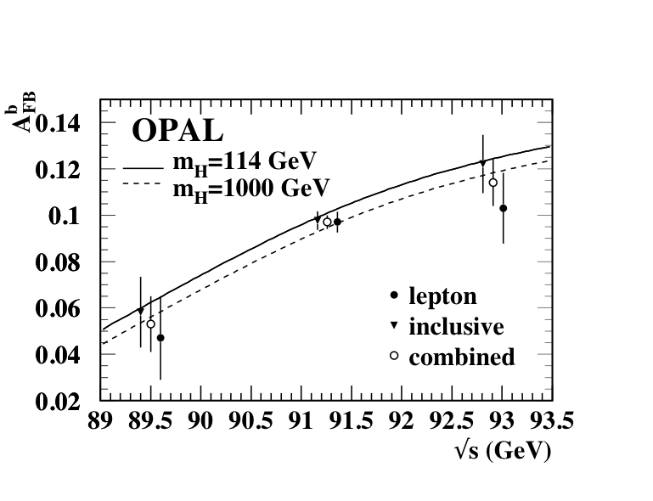
A_{FB}^{b} – an asymmetric legacy
Vertex/NN techniques
used to measure A_{FB}^{b}
R_{b}-crisis replaced by an A_{FB}^{b} crisis (tension with A_{LR} from SLD)
  This will remain unresolved for a long time (until a Giga-Z factory?)
Notes:
Plot RHS is from global ew fits, which yield stringent constraints on SM.
LHS Plot : measured Afb(b) around Z0 for different selections.

Slide 41
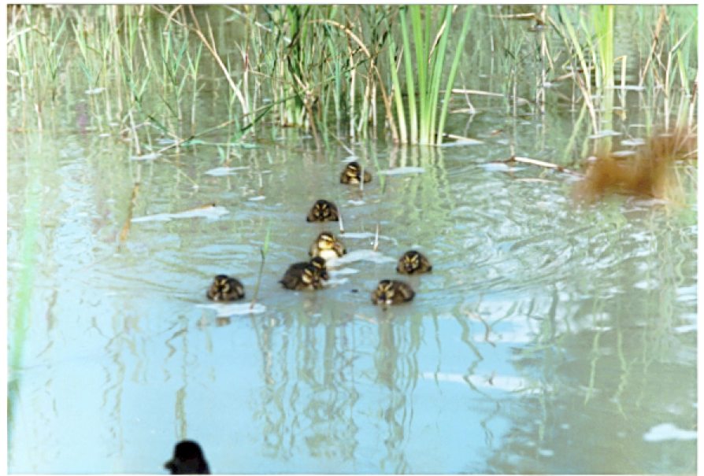
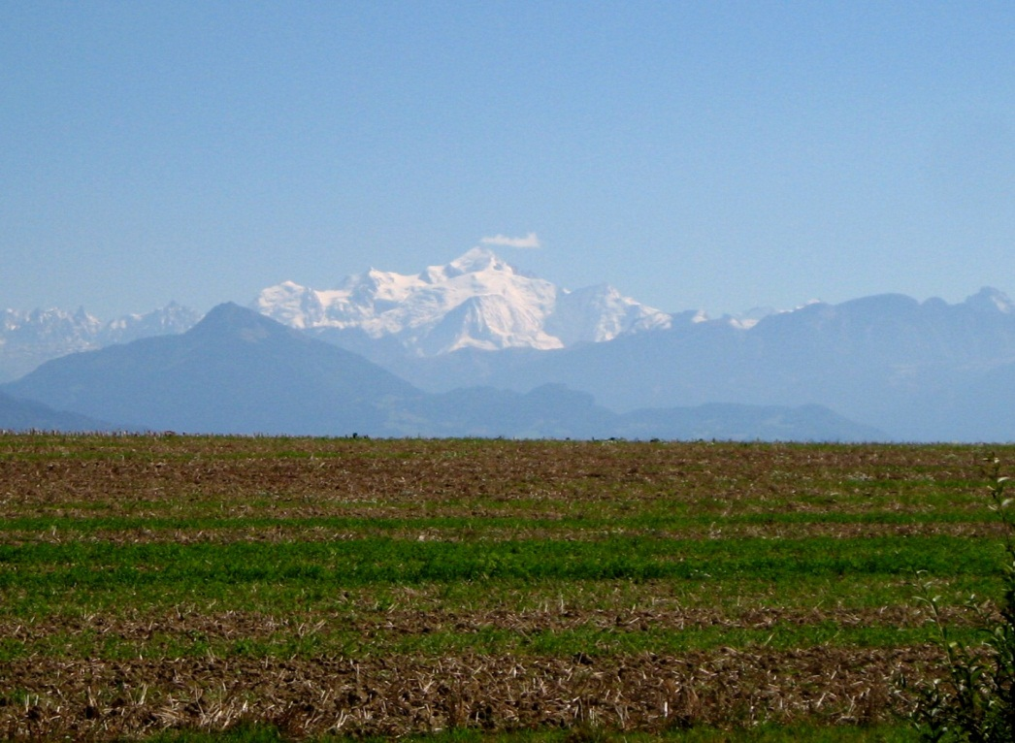
A social interlude
It’s for real - the OPAL duck pond, and the view was something !!
Notes:
Ducklings were born under the responsibility of our Technical Coordinator who didn’t fail to post the good tidings on OPALNews.

Slide 42
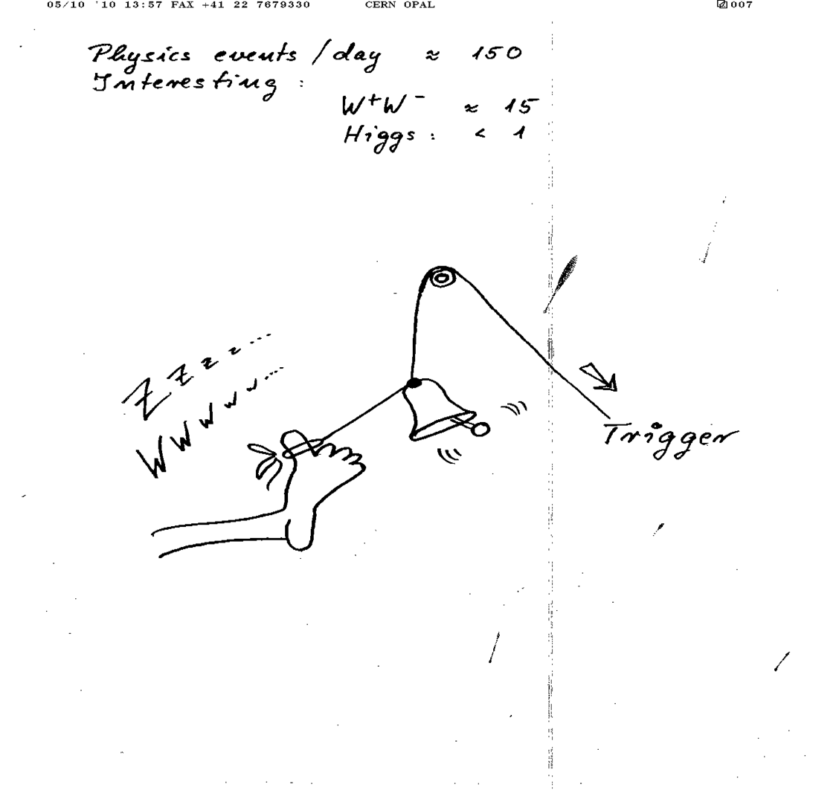
And now for LEP2 .
PIK’s impression of life on shift.

Slide 43
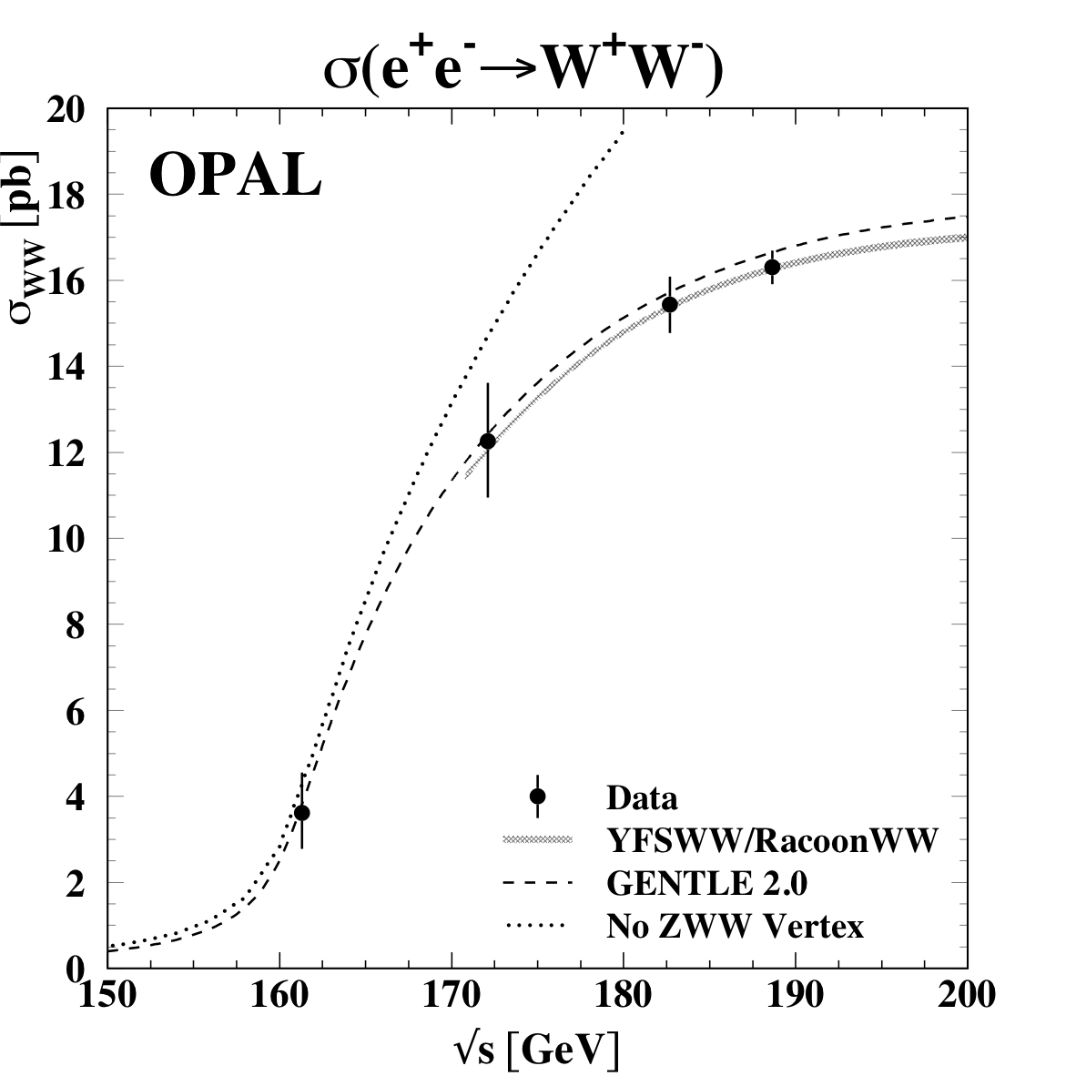
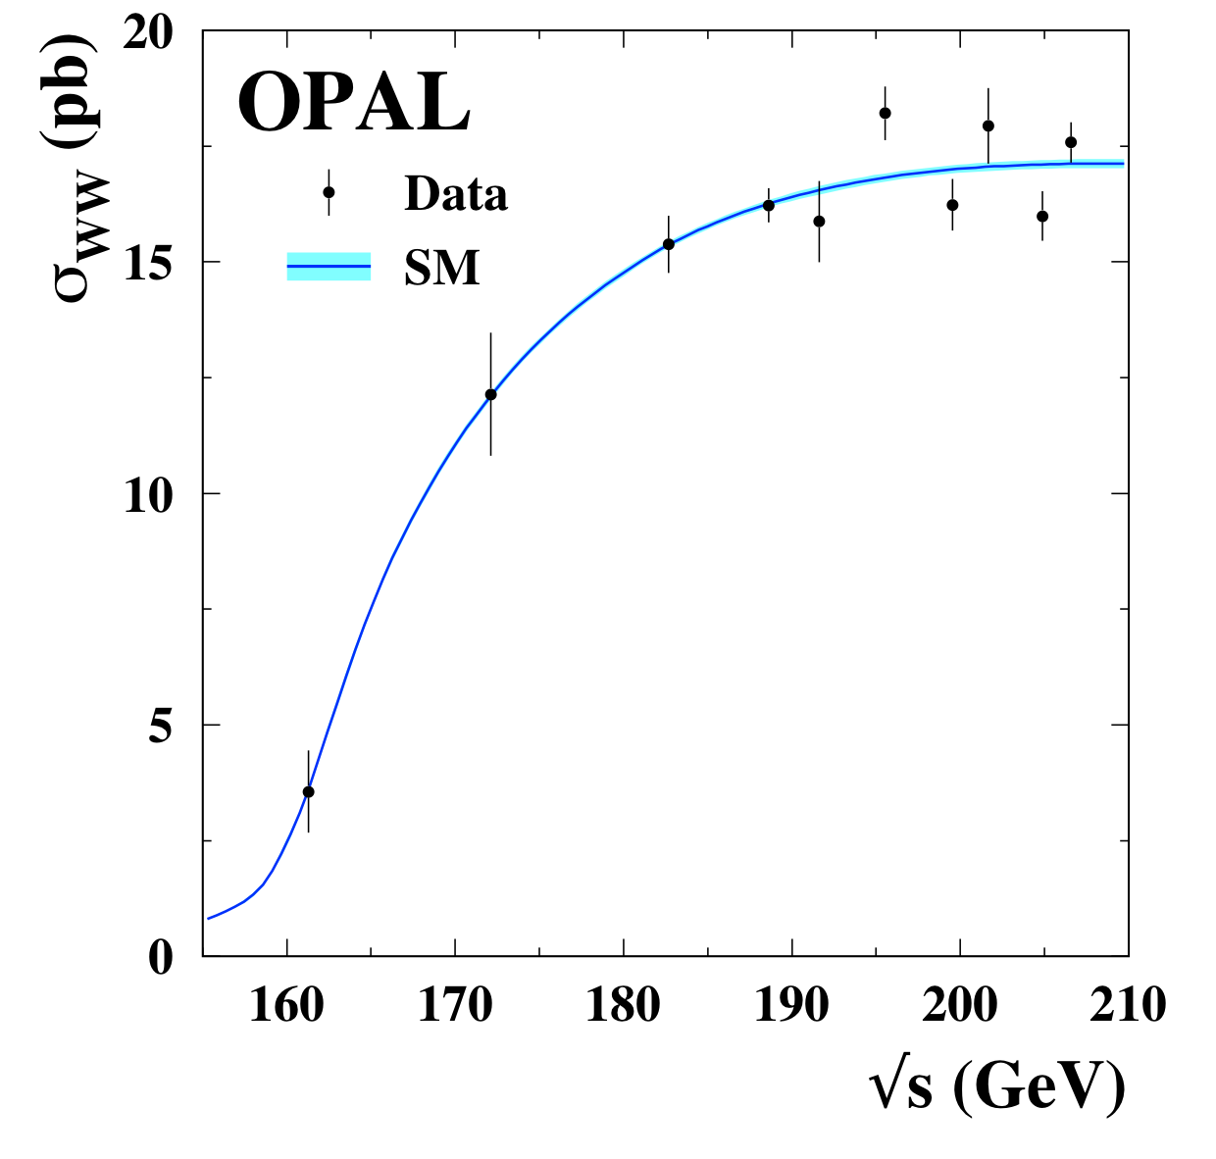
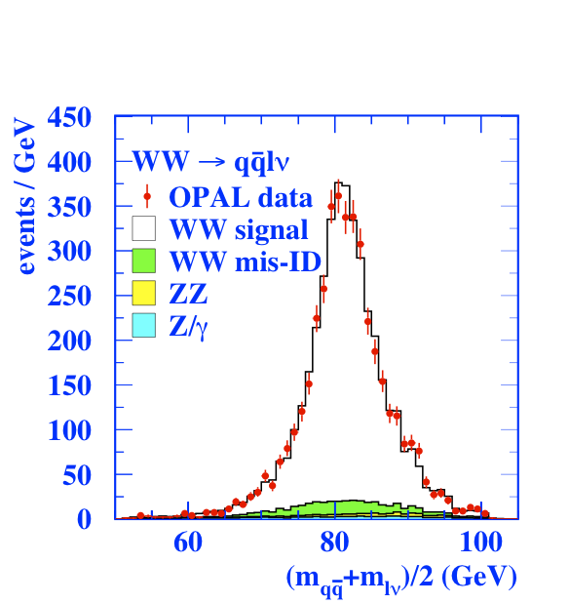
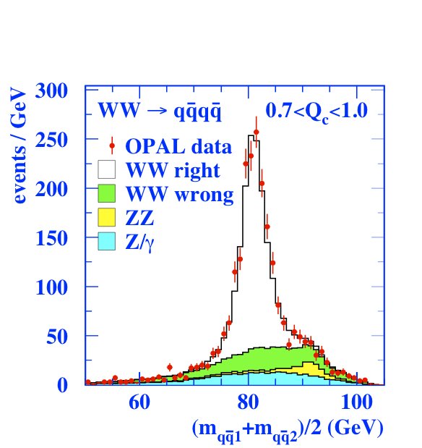
WW and the W mass
WW physics central @ LEP2
  First opportunity to study W in clean environment of e⁺e⁻ collider
  O(10k) WW events reconstructed in lνlν, qqlν and qqqq final states
  Measurement of WW production cross-section and W branching ratios
Measurement of W-boson mass
  Natural complement to LEP1 m_{Z}
  Many challenges to reach 0.06%
    Detector response (calib Zs)
    Hadronisation and precision electroweak effects
    LEP energy calibration
    Colour reconnection and BEC in 4q
  Also a measurement in lνlν!
Notes:
WW cross-section. Almost no human intervention !!!!
What are the curves?????

Slide 44



2 Fermions at LEP2
Repeat of ‘zedometry’ at higher energies
  Measurements of cross-sections and asymmetries for qq / ee / μμ / ττ
  New feature of ‘radiative return’ to Z pole
    Hard ISR photon, remainder is like Z
  Non-radiative events (large s’/s) have increased photon contribution
Notes:
Understand. S’ ????????
Left plot : cross-sections for ee, & asymmetries for mu-mu, tau-tau and e-e.
Right plot cross-section for q-qbar final states.
Good agreement with SM.

Slide 45

Particle Searches – we sought, but did not find .
LEP 1.5 : א 4-jet peak.
We sought :
Higgses of all sorts (SM, bosophilic, charged, invisible, supersymmetric).
SUSY (GMSB, RPV, …)
Leptoquarks
Excited leptons
Radions
Magnetic monopoles
Extra dimensions
Exotica
BUT found nothing !!! EXCEPT !
Notes:
4 jets : pair them and choose the combinations with the smallest mass difference, then sum them.
Sum of di-jet masses.

Slide 46

Summer/Autumn 2000
LEP scheduled to stop in September – and OPAL set-up an end-of-run party for 15 September.
July OPAL LEPC report ,
Satoru Yamashita.
Everything Standard Model (but give us more beam anyway),
UNTIL ……….

Slide 47


August 2000
…shortly before the final LEP shutdown !!
BUT, we had been down the ALEPH 4-jet road before.
[ N.B: This is a later plot : less significant effect. ]
Notes:
1- CLb is now called “local pzero”. Consistency with background only expectation.
3 4-jet candidates with excellent b-tagging.

Slide 48


Very busy autumn…
  … for the experiments and the LEP Higgs Working Group
    Fast succession of LEP combinations
    Weekly reports to the DG and LEPC Chair
    Harrassment by the Media
  1 month extension of LEP
  Nov 3 : 2.9σ “effect” at 115 GeV/c²
  Request for 1-year extension not accorded.
And what remains with final calibrations and refined analyses ??

Slide 49
Apologies to those who laboured on :
  Triple and Quartic Gauge Couplings
  searches for :
    SUSY, RPV SUSY, magnetic monopoles, leptoquarks, radions, exotic Higgs, excited leptons, exotica, extra dimensions, K-K states ….
  Higgses of most types – SUSY, invisible, fermiophobic/bosophilic, …..
  b oscillations, inclusive b-hadrons
  charm physics
  γγ physics
  ………
  detector operation etc.
& Global Electroweak Fits to combined measurements from LEP, SLD, Tevatron, …..

Slide 50


What’s Left of the Detector ?
In need of a home – please take it, but some wires are broken.
NA62 Large Angle Veto,
3,000 OPAL Pb-Glass blocks.
Notes:
Central tracking detectors.

Slide 51
Concluding Remarks
Fantastic breadth and depth of physics results from OPAL at LEP1 and 2
  High-statistics Z decays at LEP1 – Zedometry, precision QCD, tau and heavy flavour physics …
  Physics at the energy frontier with LEP2 – searches, Higgs, 2f and gauge boson physics
  A triumph for the Standard Model – it did not crack
Some of these results have/will be overtaken (Tevatron, B-factories, LHC)
  But form a ‘reference point’ for later experiments
    Invaluable data for refining our understanding and models
Some will be with us ‘forever’, or until repeated at a collider Z-factory
OPAL was a ‘small’ experiment (~320 authors) – and a great opportunity
  With 400+ papers, plenty of physics topics to study, write PhD theses, etc.
  Excellent opportunities for young people to learn, to take positions of responsibility
  And a great working environment – (nearly) always fun …..
Notes:
61 slides, -7 = 54. Remove 5-10.
Thank Jim for all his hard work and contributions, and wish him a successful, and fulfilling future research career.

Slide 52
Reserve Slides – not back-ups.

Slide 53


Direct Method - principle.
Direct determination of the Z⁰ invisible width !!!
Through the reaction e⁺e⁻ →ννγ
( plus t-channel W-exchange. )
Complementary method since it is
independent of assumption that all
Z⁰ visible decays are accounted for
in analyses of charged leptons and
multihadrons.
At energies above Z⁰ mass, events in which ISR which brings the e⁺e⁻ com energy down to Z⁰ resonance is strongly favoured.
∴run at E > mZ
and tag νν events with ISR photon.
Notes:
Skip slides 30 – 34.
For example in the INDIRECT approach, extra but visible Z decays, not properly taken into account in the hadronic and leptonic selections, would give contributions to the invisible width, whereas they would NOT affect the present analysis.
Events are selected with single e.m cluster with Eγ > 1 GeV, and no signals in tracking chambers.

Slide 54
Direct Method - principle.
The differential cross section
for e⁺e⁻ →ννγ
:
Where H is a radiator function, and
σ₀ is “reduced” cross section for e⁺e⁻ →νν at new com energy s’ .
σ_{o} has 3 terms :
  Z production and decay. Proportional to Nν. Dominant term.
  W-exchange
  Interference.
ii. and iii. contribute <5% of cross section.
Notes:
H is the radiator function for photons from the initial state with energy Eγ and polar angle θγ, s is com energy squared.
In OPAL had 450 events, for example.

Slide 55

Direct Method - experimental challenges.
LEP initially ran at com energies near to the Z0 peak ( within 3 GeV ).
Events with low energy photons, near 1 GeV, are used !
  Detector must trigger efficiently on a small amount of energy (~1% of E_{cm}) deposited in Ecal.
  γ energy spectrum falls rapidly → well calibrated detector.
In fact OPAL had such a detector, provided by University of Tokyo, and was the first to publish a direct measurement of N_{υ .}
Notes:
Main background is ee -> eeγ (radiative Bhabha’s), where the final state electrons go down the beam pipe.
OPAL LGB – see HALF here. Total of 9,440 lead-glass blocks arranged such that each block points towards the collision point, but the inter-block gaps point slightly away from the origin. When we stopped running in November 2000, all 9448 lead-glass blocks were working !
Cos(theta) < .82.
ResN : 6.3%/root(E) + .2% = sigE/E

Slide 56

Direct Method - results.
LEP1
ALEPH : Nν = 2.68 ± 0.20 ± 0.20
DELPHI: Nν = 3.15 ± 0.34
L3 : Nν = 2.98 ± 0.07 ± 0.07
OPAL : Nν = 3.23 ± 0.16 ± 0.10
L3 measured cross section, compared to predictions with
N_{ν} = 2,3, 4.
Different data samples :
ALEPH : 90-91 data. 16 pb⁻¹
DELPHI: 93-94 data. 67 pb-1
L3 : 91-94 data. 100 pb⁻¹
OPAL : 90-92 data. 40 pb⁻¹
Notes:
LEP 1

Slide 57

Direct Method - results LEP2.
LEP 2
By-product of searches for new physics
ALEPH : Nν = 2.86 ± 0.09
DELPHI: Nν = 2.84 ± 0.10 ± 0.14
L3 : Nν = 2.98 ± 0.05 ± 0.04
OPAL : Nν = 2.63 ± 0.15 ± 0.11
Notes:
Searches – photonic events with missing energy. Search for ee -> XY, X->Yγ. X,Y could be excited neutrinos, neutralinos, and Y could be a light Gravitino.
Also searches for extra dimensions. Gravitons
L3 make a binned maximum likelihood fit to 2-D distribution of Mrec vs. cos(thetaγ), which is more powerful than the cross-section method.
No LEP-combination made as far as I know. Precision roughly 10* worse than for the indirect method.
The photon in parentheses denotes the presence of this photon is allowed, but not required.

Slide 58
Back-ups

Slide 59
Those concrete dipole magnets
Temperature dependence

Slide 60

Flux Loop Measurements
Every dipole magnet has a single-turn “Flux Loop” coil installed in a groove in the lower pole.
Resolution ≈ 10⁻⁴
Corrections required :
Earth’s field -0.6 10⁻⁴
Ageing
Temperature effects
Nickel layer on vacuum chamber
etc.
But good for relative energy measurements.
Notes:
NB:
Coil incorrectly drawn – just 2 parallel bars.
No NMR probe to start with.

Slide 61


More on 2 Fermions at LEP2
All 2-fermion measurements in beautiful agreement with SM prediction
  Place limits on various 4-fermion contact interaction terms
Extract α_{EM}(LEP2) from fit to 2-f data
  Assumes SM behaviour for 0-4 GeV (lumi)
  Use ratios of cross-sections to get a fully independent α_{EM}; 4.3σ different from α_{EM}(0)

Slide 62

Global electroweak fits
July 2011
Fit to combined measurements from LEP, SLD, Tevatron, ……
Combination of the many, precise e-w results yield stringent constraints on the SM.

